Slide 1
Ben-Gurion University of the Negev
Deep Learning Seminar
Topaz Gilad, 2016
Semantic Image Segmentation With DCNN and Fully Connected CRFs
Liang-Chieh Chen et al.
ICLR 2015
DeepLab system
L.-C. Chen, G. Papandreou, I. Kokkinos, K. Murphy, and A. L. Yuille, “Semantic image segmentation with deep convolutional nets and fully connected CRFs,” in ICLR, 2015.
Notes:
ICLR - International Conference on Learning Representations

Slide 2
Topics
Introduction
Semantic Segmentation
DCNN for segmentation
‘Holes’ algorithm
Boundary recovery
Probabilistic Graphical Models
Fully Connected CRFs

Slide 3
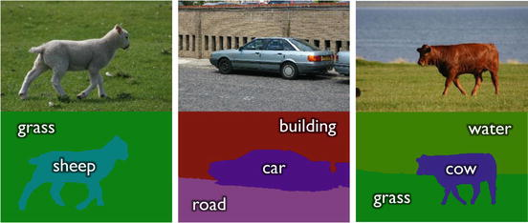
Introduction
What is semantic image segmentation?
Partitioning an image into regions of meaningful objects.
Assign an object category label.
Jamie Shotton and Pushmeet Kohli, Semantic Image Segmentation, Computer Vision, pp 713-716, Springer, 2016.

Slide 4
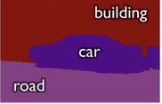
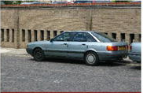
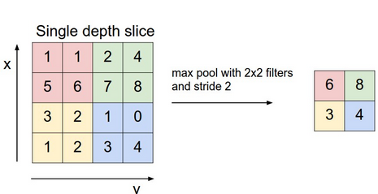
Introduction
DCNN and image segmentation
DCNN
Select maximal score class
Class prediction scores for each pixel
What happens in each standard DCNN layer?
Striding
Pooling
http://cs231n.github.io/convolutional-networks/#pool
Notes:
Stride: by how much we shift the filter at each step.
Pooling: replaces the output of the net at a certain location with a summary statistic of the nearby outputs (e.g. max, avg…).

Slide 5
Introduction
DCNN and image segmentation
Pooling advantages:
Invariance to small translations of the input.
Helps avoid overfitting.
Computational efficiency.
Striding advantages:
Fewer applications of the filter.
Smaller output size.
Notes:
Striding computational efficiency – fewer applications of the filter and smaller output size.

Slide 6
Introduction
DCNN and image segmentation
What are the disadvantages for semantic segmentation?
Down-sampling causes loss of information.
The input invariance harms the pixel-perfect accuracy.
DeepLab address those issues by:
Atrous convolution (‘Holes’ algorithm).
CRFs (Conditional Random Fields).
Notes:
Invariance is desirable for high-level vision tasks (example: we need not know the location of the eyes with pixel-perfect accuracy, we just need to know that there is an eye on the left side of the face and an eye on the right side of the face).
However, it harms pixel-wise semantic segmentation!
Holes - ‘trous’ in French

Slide 7
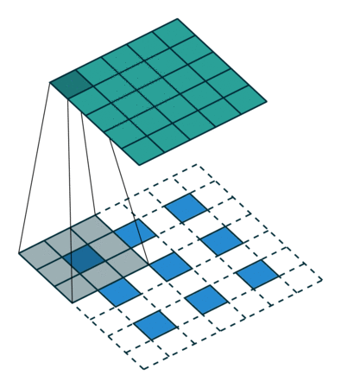
Up-Sampling
Addressing the reduced resolution problem
Possible solution:
‘deconvolutional’ layers (backwards convolution).
Additional memory and computational time.
Learning additional parameters.
Suggested solution:
Atrous (‘Holes’) convolution
https://github.com/vdumoulin/conv_arithmetic

Slide 8
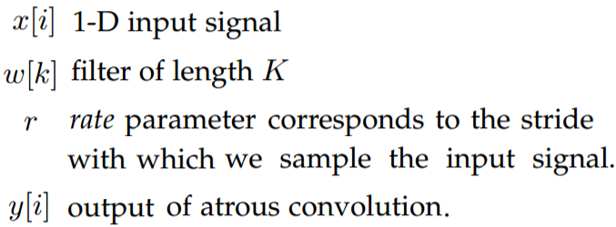
Atrous (‘Holes’) Algorithm
Remove the down-sampling from the last pooling layers.
Up-sample the original filter by a factor of the strides: Atrous convolution for 1-D signal:
Note: standard convolution is a special case for rate r=1.
Introduce zeros between filter values
Chen, Liang-Chieh, et al. "DeepLab: Semantic Image Segmentation with Deep Convolutional Nets, Atrous Convolution, and Fully Connected CRFs." arXiv preprint arXiv:1606.00915 (2016).

Slide 9
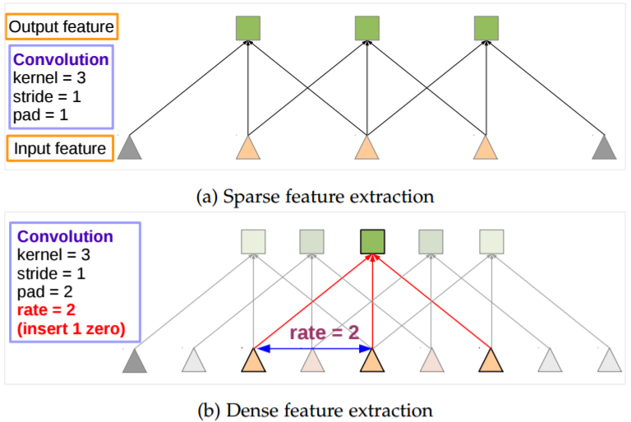
Atrous (‘Holes’) Algorithm
Standard convolution
Atrous
convolution
Chen, Liang-Chieh, et al. "DeepLab: Semantic Image Segmentation with Deep Convolutional Nets, Atrous Convolution, and Fully Connected CRFs." arXiv preprint arXiv:1606.00915 (2016).
Notes:
Add “holes”: introduce zeros between filter values.
We wish to get “stride 1” resolution using effective “stride 2” (r=2).

Slide 10
Atrous (‘Holes’) Algorithm
Filters field-of-view
Small field-of-view → accurate localization
Large field-of-view → context assimilation
‘Holes’: Introduce zeros between filter values.
Effective filter size increases (enlarge the field-of-view of filter):
However, we take into account only the non-zero filter values:
Number of filter parameters is the same.
Number of operations per position is the same.
Chen, Liang-Chieh, et al. "DeepLab: Semantic Image Segmentation with Deep Convolutional Nets, Atrous Convolution, and Fully Connected CRFs." arXiv preprint arXiv:1606.00915 (2016).
Notes:
DeepLab use r=12.

Slide 11
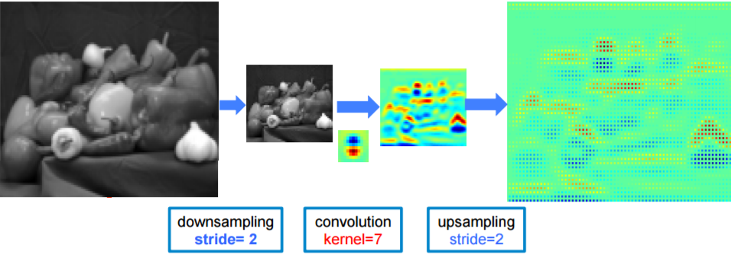
Atrous (‘Holes’) Algorithm
Originalfilter
Standard convolution
Padded filter
Atrous
convolution
Chen, Liang-Chieh, et al. "DeepLab: Semantic Image Segmentation with Deep Convolutional Nets, Atrous Convolution, and Fully Connected CRFs." arXiv preprint arXiv:1606.00915 (2016).
Notes:
Standard convolution: obtained responses at only 1/4 of the image positions.

Slide 12
Boundary recovery
DCNN trade-off: Classification accuracy ↔ Localization accuracy
DCNN score maps successfully predict classification and rough position.
Less effective for exact outline.
Chen, Liang-Chieh, et al. "DeepLab: Semantic Image Segmentation with Deep Convolutional Nets, Atrous Convolution, and Fully Connected CRFs." arXiv preprint arXiv:1606.00915 (2016).
Notes:
Deeper models with multiple pooling layers are successful in classification tasks.
However, their increased invariance and large receptive fields are not suited for inferring position.
Super-pixel: grouping pixels into perceptually meaningful small patches, used to replace the pixel grid.

Slide 13
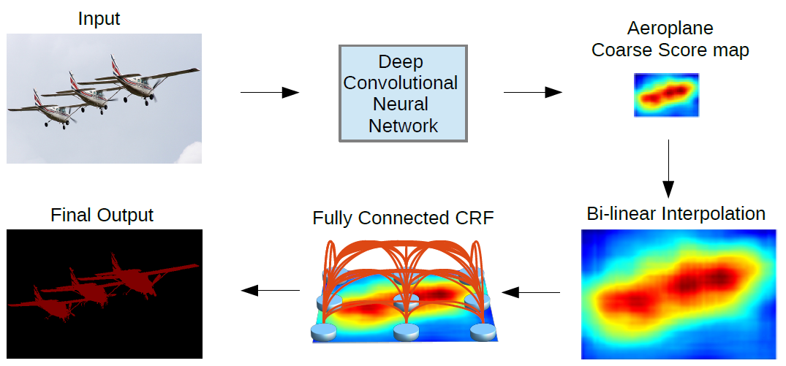
Boundary recovery
Possible solution: super-pixel representation.
Suggested Solution: fully connected CRFs.
L.-C. Chen, G. Papandreou, I. Kokkinos, K. Murphy, and A. L. Yuille, “Semantic image segmentation with deep convolutional nets and fully connected CRFs,” in ICLR, 2015.
https://www.researchgate.net/figure/225069465_fig1_Fig-1-Images-segmented-using-SLIC-into-superpixels-of-size-64-256-and-1024-pixels
Notes:
Super-pixel: grouping pixels into perceptually meaningful small patches, used to replace the pixel grid.

Slide 14
Conditional Random Fields
Problem statement
- Random field of input observations (images) of size N.
- Set of labels.
- Random field of pixel labels.
- color vector of pixel j.
- label assigned to pixel j.
CRFs are usually used to model connections between different images.
Here we use them to model connection between image pixels!
P. Krahenbuhl and V. Koltun, “Efficient inference in fully connected CRFs with Gaussian edge potentials,” in NIPS, 2011.

Slide 15
Probabilistic Graphical Models
Graphical Model
Factorization - a distribution over many variables represented as a product of local functions, each depends on a smaller subset of variables.
C. Sutton and A. McCallum, “An introduction to Conditional Random Fields”, Foundations and Trends in Machine Learning, vol. 4, No. 4 (2011) 267–373

Slide 16
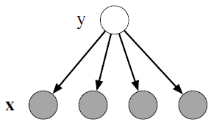
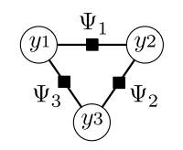
Probabilistic Graphical Models
Undirected vs. Directed
G(V, F, E)
Undirected
Directed
C. Sutton and A. McCallum, “An introduction to Conditional Random Fields”, Foundations and Trends in Machine Learning, vol. 4, No. 4 (2011) 267–373
Notes:
A directed graph describes how a distribution factorizes into local conditional probability distribution

Slide 17
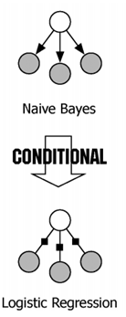
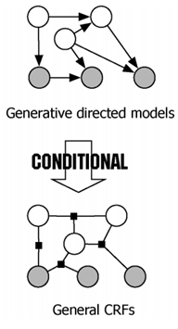
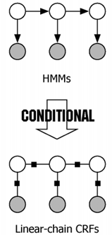
Probabilistic Graphical Models
Generative-Discriminative pairs:
One variable
Sequence (Markov)
General
Directed
Undirected
C. Sutton and A. McCallum, “An introduction to Conditional Random Fields”, Foundations and Trends in Machine Learning, vol. 4, No. 4 (2011) 267–373

Slide 18
Conditional Random Fields
Fully connected CRFs
Definition:
Z(X) - is an input-dependent normalization factor.
Factorization (energy function):
y - is the label assignment for pixels.
P. Krahenbuhl and V. Koltun, “Efficient inference in fully connected CRFs with Gaussian edge potentials,” in NIPS, 2011.
C. Sutton and A. McCallum, “An introduction to Conditional Random Fields”, Foundations and Trends in Machine Learning, vol. 4, No. 4 (2011) 267–373

Slide 19
Conditional Random Fields
Potential functions in our case
- is the label assignment probability for pixel i computed by DCNN.
- position of pixel i.
- intensity (color) vector of pixel i.
- learned parameters (weights).
- hyper parameters (what is considered “near” / “similar”).
$$p\left(y_{i}|X\right)$$
$$s_{i}$$
$$x_{i}$$
$θ_{1}$, $θ_{2}$
$$σ_{a}^{2},σ_{b}^{2}, σ_{γ}^{2}$$
Chen, Liang-Chieh, et al. "DeepLab: Semantic Image Segmentation with Deep Convolutional Nets, Atrous Convolution, and Fully Connected CRFs." arXiv preprint arXiv:1606.00915 (2016).

Slide 20
Conditional Random Fields
Potential functions in our case
Bilateral kernel – nearby pixels with similar color are likely to be in the same class.
- what is considered “near” / “similar”).
Pixels “nearness”
Pixels color similarity
$$σ_{a}^{2},σ_{b}^{2}$$
Chen, Liang-Chieh, et al. "DeepLab: Semantic Image Segmentation with Deep Convolutional Nets, Atrous Convolution, and Fully Connected CRFs." arXiv preprint arXiv:1606.00915 (2016).

Slide 21
Conditional Random Fields
Potential functions in our case
– uniform penalty for nearby pixels with different labels.
Insensitive to compatibility between labels!
$$1_{y_{i}≠y_{j}}$$
P. Krahenbuhl and V. Koltun, “Efficient inference in fully connected CRFs with Gaussian edge potentials,” in NIPS, 2011.
Notes:
Penalizes a pair of nearby pixels labeled “sky” and “bird” to the same extent as pixels labeled “sky” and “cat”.
P. Krahenbuhl et al. present al learning process for a more general penalty to get maximal log likelihood.

Slide 22
Boundary recovery
Score map
Belief map
L.-C. Chen, G. Papandreou, I. Kokkinos, K. Murphy, and A. L. Yuille, “Semantic image segmentation with deep convolutional nets and fully connected CRFs,” in ICLR, 2015.
Notes:
pixels into perceptually meaningful small patches, used to replace the pixel grid.

Slide 23
DeepLab
Group:
CCVL (Center for Cognition, Vision, and Learning).
Basis networks (pre-trained for ImageNet):
VGG-16 (Oxford Visual Geometry Group, ILSVRC 2014 1st).
ResNet-101 (Microsoft Research Asia, ILSVRC 2015 1st).
Code: https://bitbucket.org/deeplab/deeplab-public/
Notes:
ILSVRC - ImageNet Large Scale Visual Recognition Challenge

Slide 24
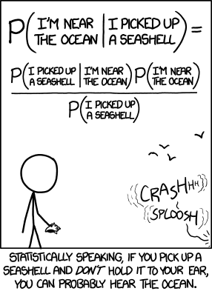
Thank You!
Image is from: http://imgs.xkcd.com/comics/seashell.png
C. Sutton and A. McCallum, “An introduction to Conditional Random Fields”, Foundations and Trends in Machine Learning, vol. 4, No. 4 (2011) 267–373

