Slide 1
Learning to Compare Image Patches via Convolutional Neural Networks
Sergey Zagoruyko & Nikos Komodakis
Presented by Ilan Schvartzman

Slide 2
Problem description
- Matching two patches in the general case (where occlusions, difference in illumination, shading etc.) is a non trivial task.
- A wide range of applications such as, stereo matching, registration and in many cases an essential preprocess step
- Up until now the problem was solved using descriptors such as Scale-Invariant-Feature-Transform

Slide 3
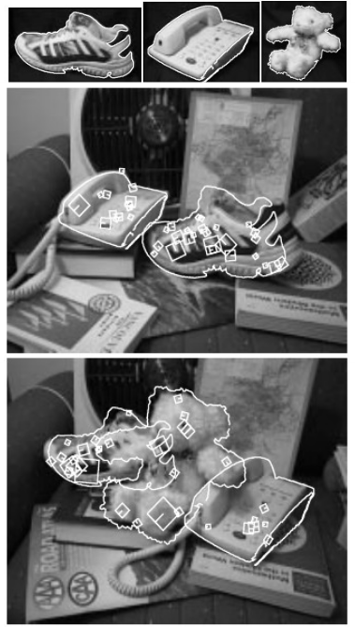
SIFT
Seeking interesting points, easy to distinguish
Creating a local descriptor for the point, that remains invariant to scaling, rotation and translation.

Slide 4
The goal of the article
Generating a patch similarity function without attempting to use any manually designed features, but directly learn it.

Slide 5
Preliminary assumptions
Only grayscale image was used (since this is the only available labeled training set they had).
Patch size is 64*64 (with the exception of SPP model described later)
Three basic architectures were proposed

Slide 6
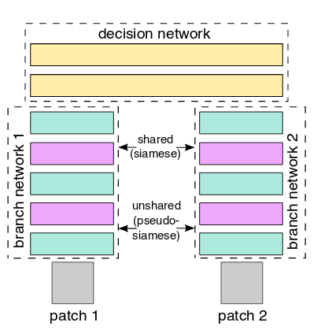
Siamese\Pseudo-Siamese architecture
Similar to having a descriptor.
Each patch has a branch.
In the Siamese the weights are forced to
be the same in both branches, in the
Pseudo they are not.

Slide 7
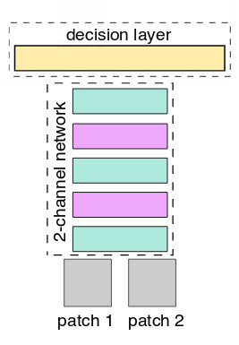
Two channel
Both patches are inserted as a two channel
image.
The structure is similar to a classification CNN.
Harder for testing

Slide 8
Deep Networks
The patch is broken into convolutional layers of 3*3 separated by ReLU activations, therefore deep CNN can be created.
Accounts for the non-linearities in the data.

Slide 9
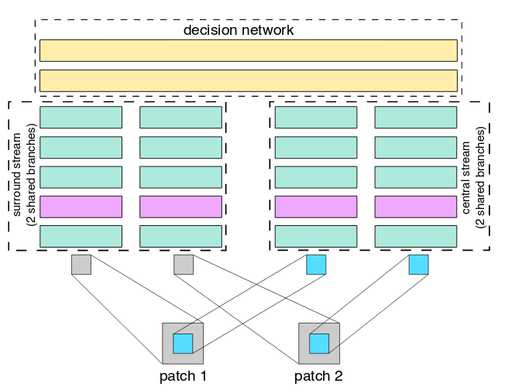
Central surround two stream network
Two branches – one for the center, one for the whole patch.
Assuming the information in the
information in the center
should be taken with greater
significance.

Slide 10
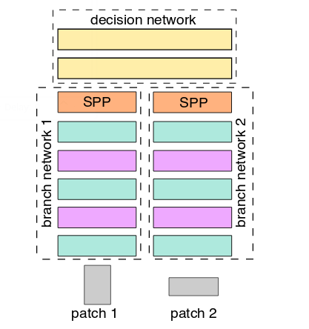
Spatial Pyramid Pooling – SPP
The input patches can be of different size.
The last layer’s pooling should be
proportional to the patch’s size.

Slide 11
Learning
All Models are trained in a strongly supervised manner using hinge-based loss term and squared l2-norm regularization.
w are the weights of the neural network
O_{i}^{net} is the network output for the i-th training sample
Y_{i} corresponds to {1,-1}
ASGD with constant learning rate 1.0, momentum 0.9 and weight decay = 0:0005 is used to train the models.
Training is done in mini-batches of size 128.

Slide 12
Data Augmentation
In order to increase the training set the data was flipped vertically and horizontally, as well as rotated hence using 8 times each sample

Slide 13
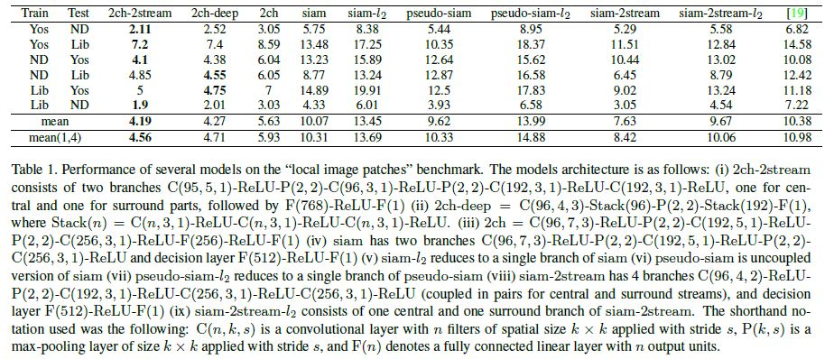
Experiments
Local image patches benchmark
For obtaining the image patch benchmark, a standard benchmark dataset [Image descriptor data] that consists of three subsets, Yosemite, Notre Dame, and Liberty, each of which contains more than 450,000 image patches (64 x 64 pixels) sampled around Difference of Gaussians feature points is used .

Slide 14
Experiments
Local image patches benchmark
2-channel-based architectures (e.g., 2ch, 2ch-deep, 2ch-2stream) exhibit the best performance among all models. This indicates that it is important to jointly use information from both patches right from the first layer of the network.
2ch-2stream managed to outperform the previous state-of-the-art model by a large margin. The difference with SIFT is also larger, with the current model giving 6.65 times better score in this case.
Performance of Siamese models when their top decision layer is replaced with the L2 Euclidean distance of the two convolutional descriptors is analysed. In this case, prior to applying the Euclidean distance, the descriptors are L2-normalized. For pseudo-Siamese only one branch was used to extract descriptors. In this case the two-stream network (siam-2stream-L2) computes better distances than the Siamese network (siam-L2), which, in turn, computes better distances than the pseudo-Siamese model (pseudo-siam-L2).

Slide 15
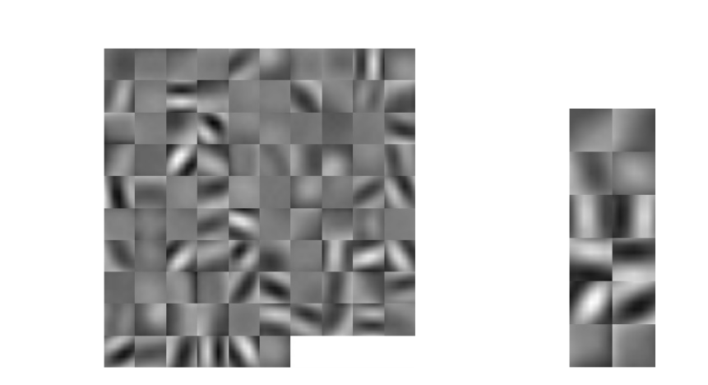
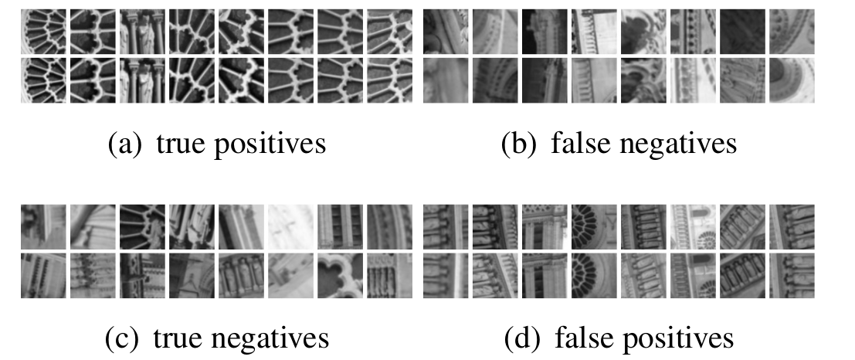
Experiments
Local image patches benchmark

Slide 16
Experiments
Wide baseline stereo evaluation
For this evaluation, the “fountain “ dataset made by Strecha et al [Multi-view evaluation] is used. This contains several image sequences with ground truth homographies and laser-scanned depthmaps.
The goal was to show that a photometric cost computed with neural network competes favourably against costs produced by a state-of-the-art hand-crafted feature descriptor, so we chose to compare with DAISY.

Slide 17
Conclusions
This article explains several ways of comparing patches using CNN. Most of the architectures described in the article show improved results comparing to a non-neural networks algorithms.
It can be noted that 2-channel-based ones were clearly the superior in terms of results. It is, therefore, worth investigating how to further accelerate the evaluation of these networks in the future.
Regarding Siamese-based architectures, 2-stream multi-resolution models turned out to be extremely strong, providing always a significant boost in performance and verifying the importance of multi-resolution information when comparing patches.

