Slide 1
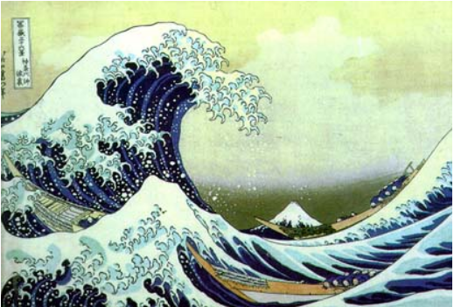
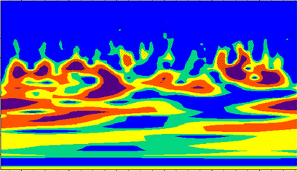
Digital Image Processing
Lecture 5
DCT & Wavelets
Tammy Riklin Raviv
Electrical and Computer Engineering
Ben-Gurion University of the Negev

Slide 2
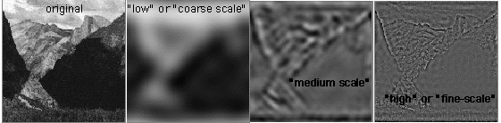
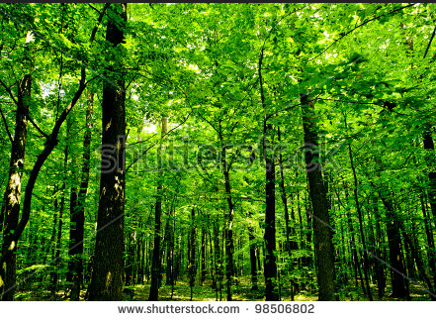
Spatial Frequency Analysis
images of naturally occurring scenes or objects (trees, rocks,
bushes, etc.) tend to contain information at many different spatial
scales, from very fine to very coarse.
Can’t
see the forest for the trees

Slide 3

Spatial Frequency Analysis
Campbell-Robson contrast sensitivity curve
http://www.psy.vanderbilt.edu/courses/hon185/SpatialFrequency/SpatialFrequency.html

Slide 4
This class
Why transform?
Discrete Cosine Transform
Jpeg Compression
Wavelets

Slide 5
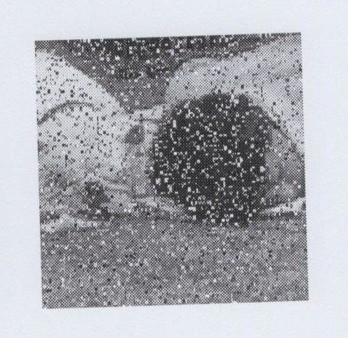
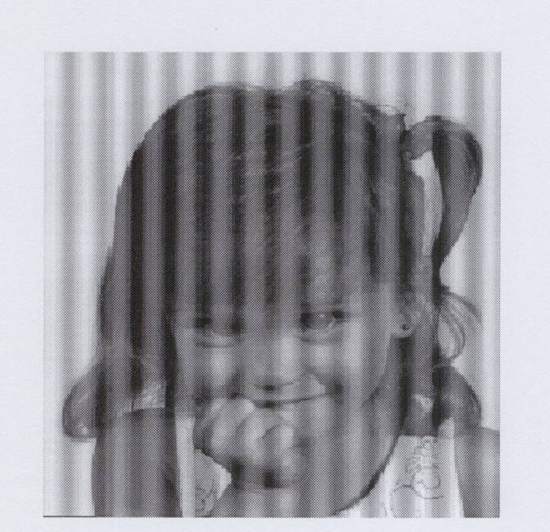
why transform?
Better image processing
  Take into account long-range correlations in space
  Conceptual insights in spatial-frequency information.
  what it means to be “smooth, moderate change, fast change, …”
  Denoising

Slide 6
why transform?
Better image processing
  Take into account long-range correlations in space
  Conceptual insights in spatial-frequency information.
  what it means to be “smooth, moderate change, fast change, …”
  Denoising
Fast computation: convolution vs. multiplication

Slide 7
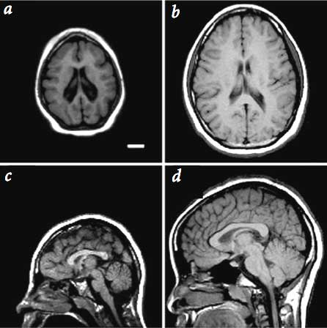
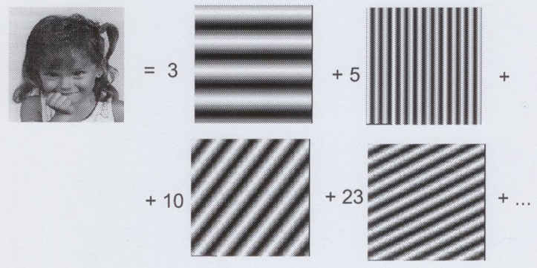
why transform?
Better image processing
  Take into account long-range correlations in space
  Conceptual insights in spatial-frequency information.
  what it means to be “smooth, moderate change, fast change, …”
  Denoising
  Fast computation: convolution vs. multiplication
Alternative representation and sensing
  Obtain transformed data as measurement in radiology images (medical and astrophysics), inverse transform to recover image

Slide 8
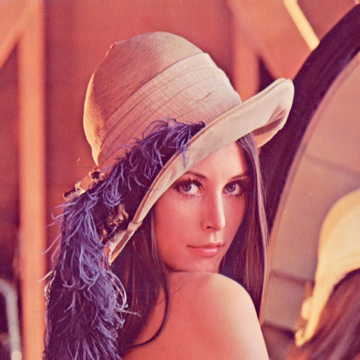

why transform?
Better image processing
  Take into account long-range correlations in space
  Conceptual insights in spatial-frequency information.
  what it means to be “smooth, moderate change, fast change, …”
  Denoising
Fast computation: convolution vs. multiplication
Alternative representation and sensing
  Obtain transformed data as measurement in radiology images (medical and astrophysics), inverse transform to recover image
Efficient storage and transmission
  Energy compaction
  Pick a few “representatives” (basis)
  Just store/send the “contribution” from each basis
?

Slide 9
Is DFT a Good (enough) Transform?
Theory
Implementation
Application

Slide 10
The Desirables for Image Transforms
DFT
???
Theory
  Inverse transform available
  Energy conservation (Parsevell)
  Good for compacting energy
  Orthonormal, complete basis
  (sort of) shift- and rotation invariant
Implementation
  Real-valued
  Separable
  Fast to compute w. butterfly-like structure
  Same implementation for forward and inverse transform
Application
  Useful for image enhancement
  Capture perceptually meaningful structures in images
X X ?
X X
x X X X
X X

Slide 11
Discrete Cosine Transform - overview
One-dimensional DCT
Orthogonality
Two-dimensional DCT
Image Compression (grayscale, color)

Slide 12
Discrete Cosine Transform (DCT)
A variant of the Discrete Fourier Transform – using only real numbers
Periodic and symmetric
The energy of a DCT transformed data (if the original data is correlated) is concentrated in a few coefficients – well suited for compression.
A good approximation to the optimal Karhunen-Loeve (KL) decomposition of natural image statistics over a small patches

Slide 13
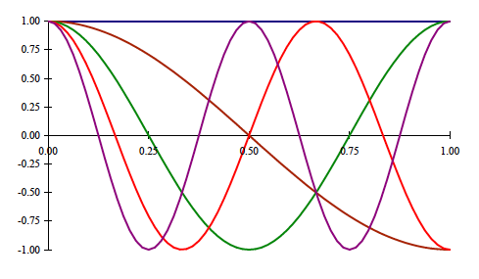
1-D DCT

Slide 14

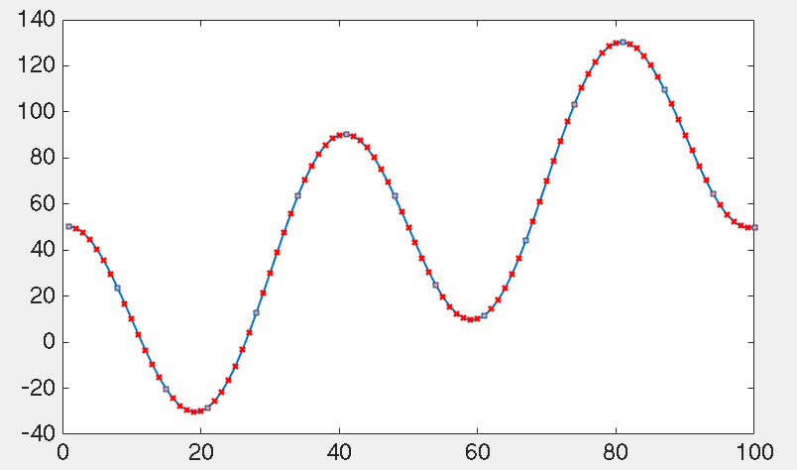
1-D DCT with Matlab

Slide 15
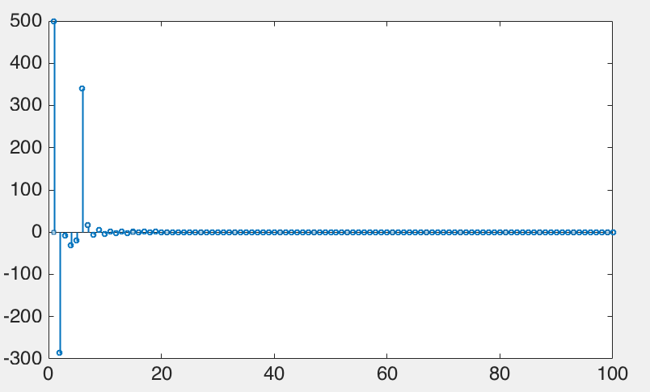
1-D DCT with Matlab

Slide 16

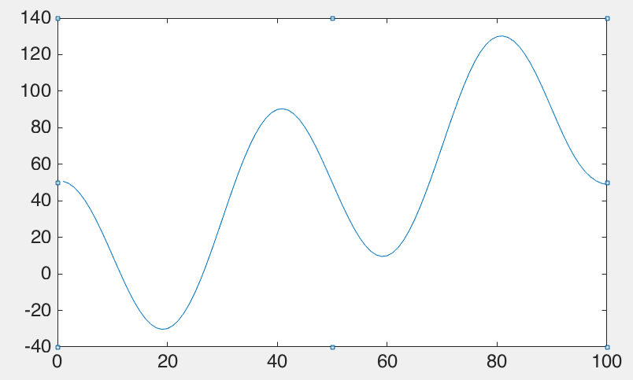
1-D Inverse DCT in Matlab

Slide 17
1-D Inverse DCT in Matlab

Slide 18
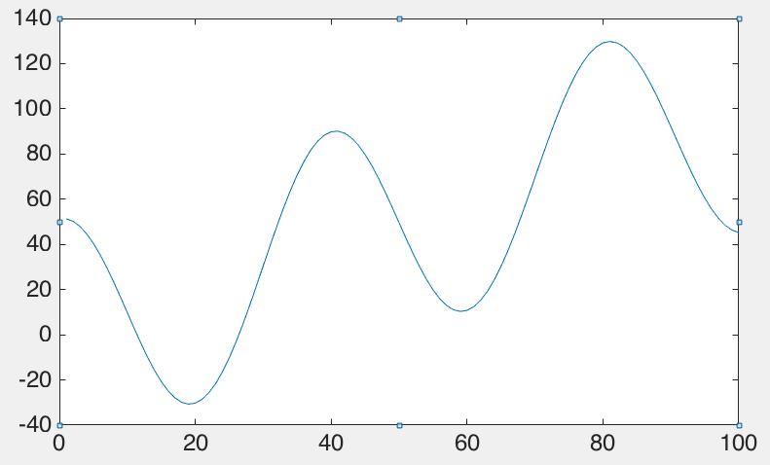
1-D Inverse DCT in Matlab

Slide 19
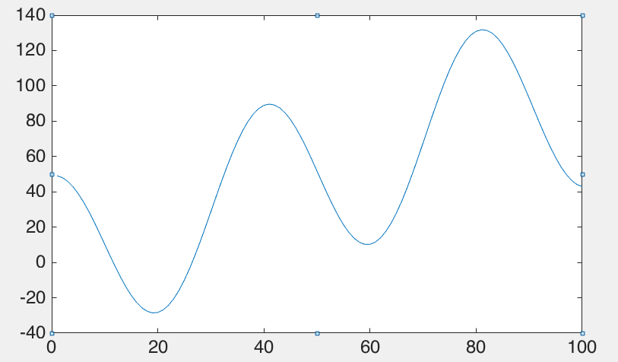
1-D Inverse DCT in Matlab

Slide 20
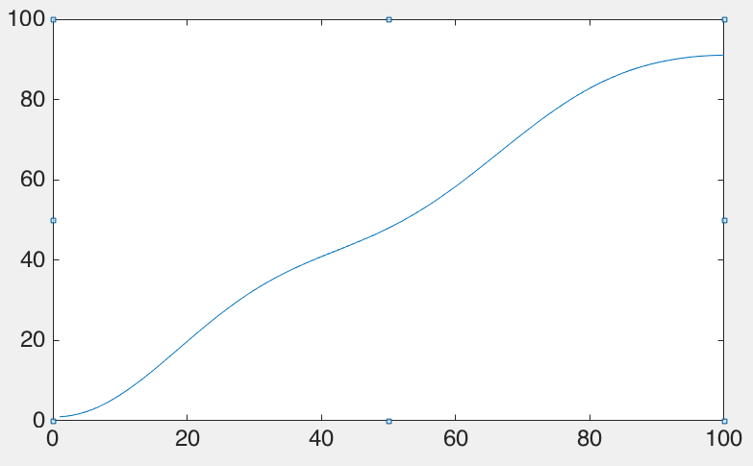
1-D Inverse DCT in Matlab

Slide 21
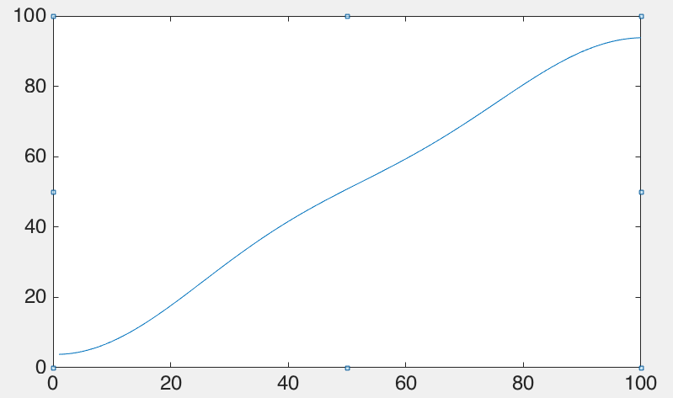
1-D Inverse DCT in Matlab

Slide 22
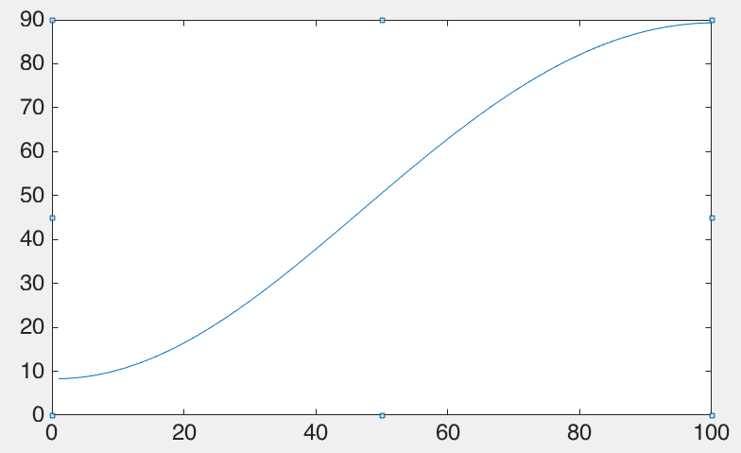
1-D Inverse DCT in Matlab

Slide 23

1-D Inverse DCT in Matlab

Slide 24
Orthogonality and Orthonormality
Two vectors, and , with respective lengths
are orthogonal if and only if their dot product
is zero.
In addition, two vectors in an inner product space are
orthonormal if they are orthogonal and both of unit length.

Slide 25
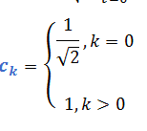
Orthogonality of the DCT

Slide 26
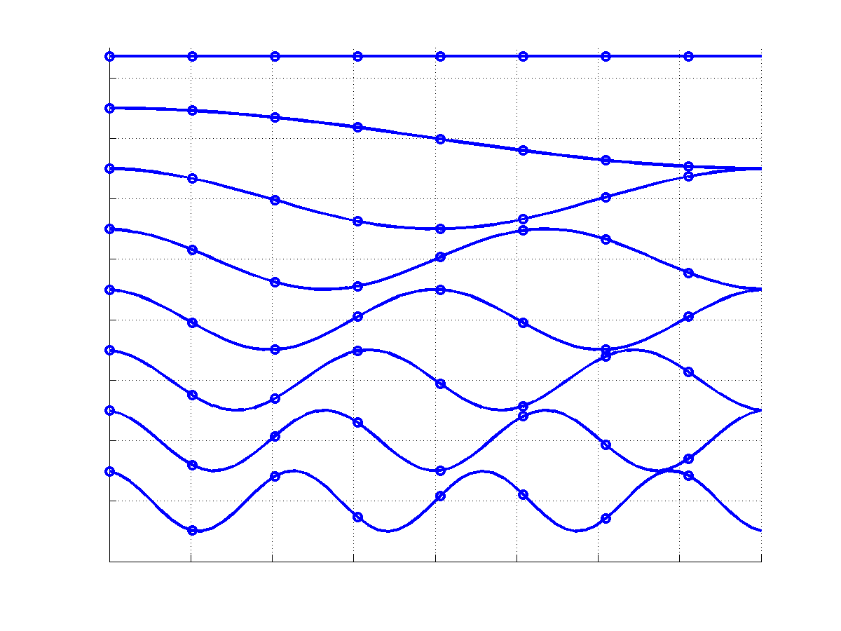
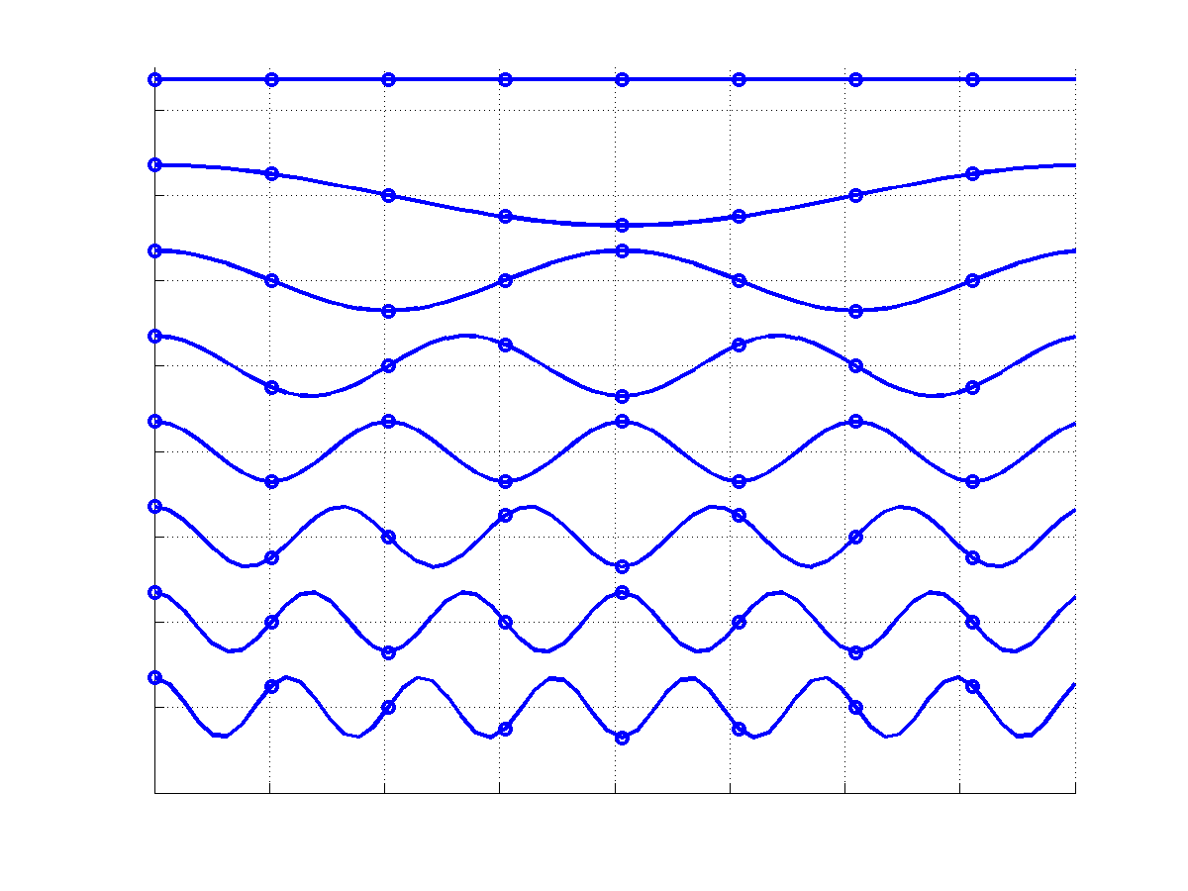
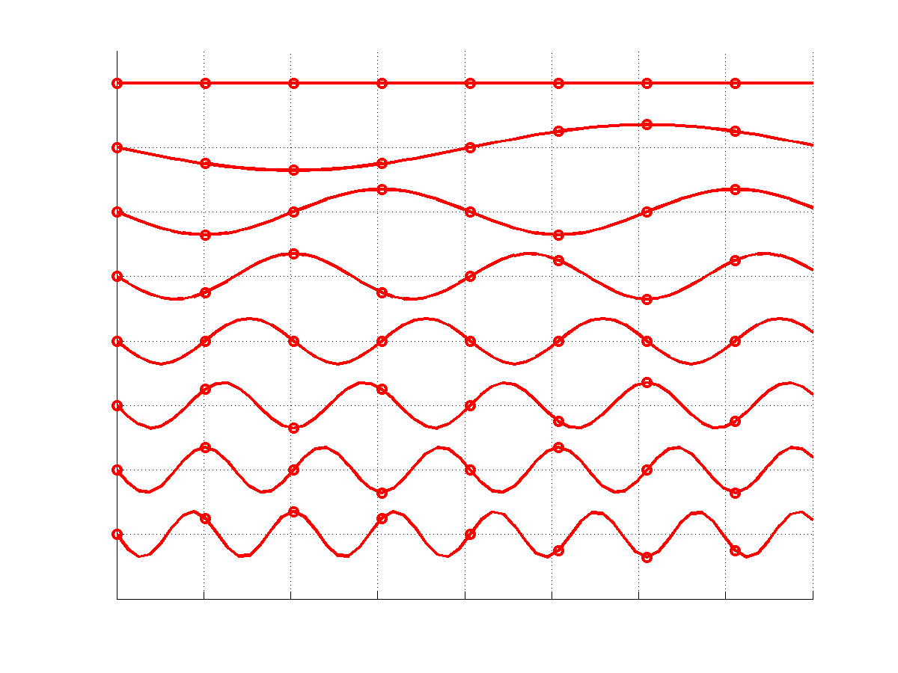
DFT vs. DCT
1D-DFT
1D-DCT
real(a)
imag(a)

Slide 27
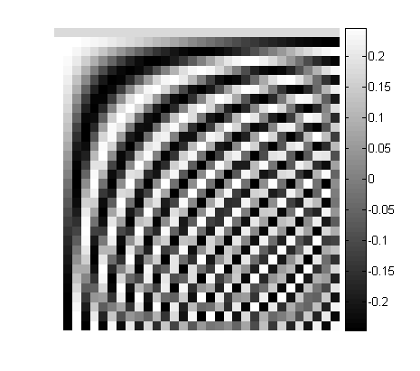
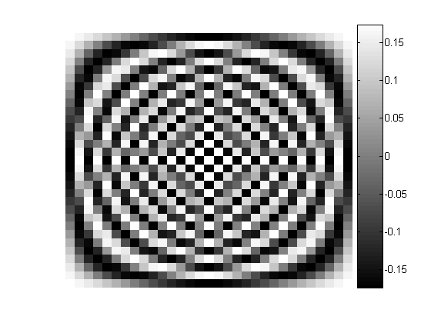
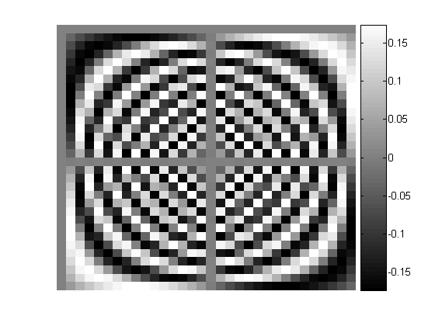
DFT vs. DCT – Matrix notation
1D-DCT
1D-DFT
N=32
real(C)
imag(C)

Slide 28
DCT Properties
is real and orthogonal:
The rows of form an orthogonal basis.
is not symmetric!
DCT is not the real part of unitary DFT!

Slide 29
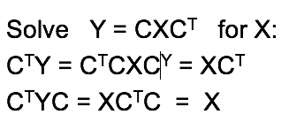
The Advantage of Orthogonality
is orthogonal.
Makes matrix equation solving easy:

Slide 30
The Advantage of Orthogonality
The discrete cosine transform, C, has one basic characteristic: it is a real orthogonal matrix.

Slide 31
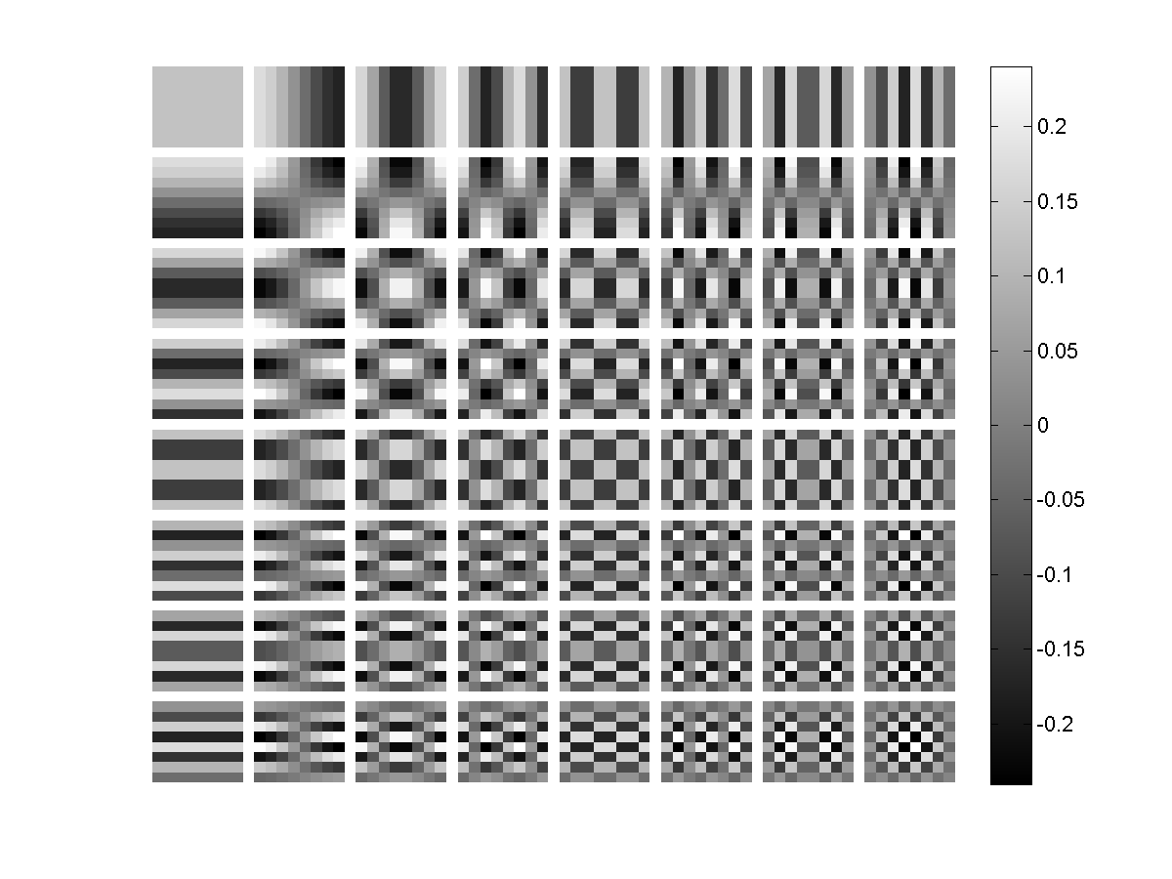
From 1D-DCT to 2D-DCT

Slide 32
2D DCT
Like the 2D Fast Fourier Transform, the 2D DCT can be implemented in two stages, i.e., first
computing the DCT of each line in the block and then computing the DCT of each resulting column.
Like the FFT, each of the DCTs can also be computed in O(N logN) time.

Slide 33

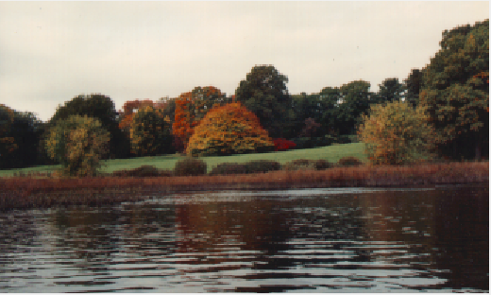
DCT in Matlab

Slide 34

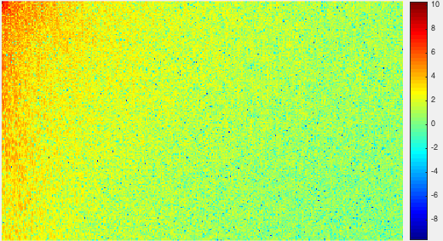
DCT in Matlab

Slide 35

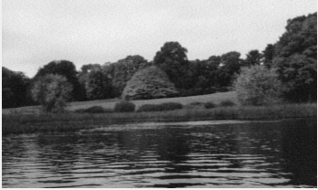
DCT in Matlab

Slide 36
2D - DCT
Idea 2D-DCT: Interpolate the data with a set of basis functions
Organize information by order of importance to the human visual system
Used to compress small blocks of an image
(8 x 8 pixels in our case)

Slide 37
2D DCT
Use One-Dimensional DCT in both horizontal and vertical directions.
First direction F = C*X^{T}
Second direction G = C*F^{T}
We can say 2D-DCT is the matrix:
Y = C(CX^{T})^{T}

Slide 38
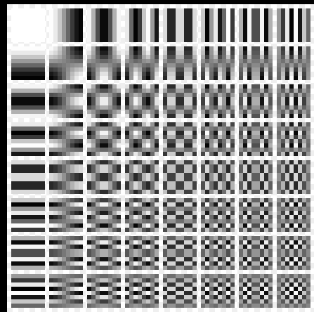
2D DCT

Slide 39
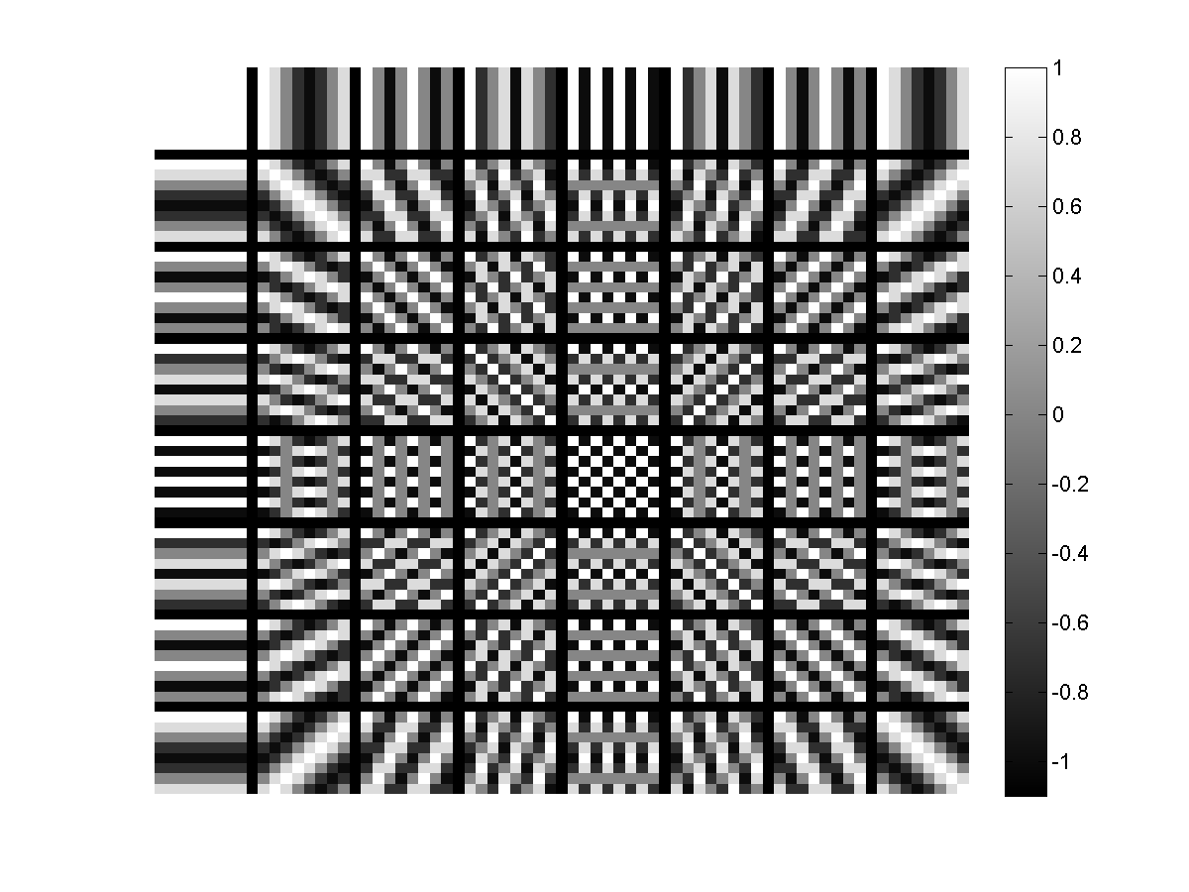
basis images: DFT (real) vs DCT
DFT
DCT

Slide 40
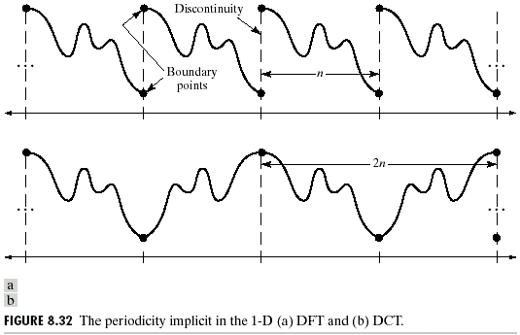
Periodicity Implied by DFT and DCT

Slide 41



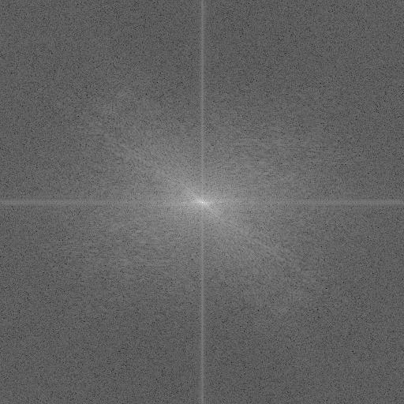
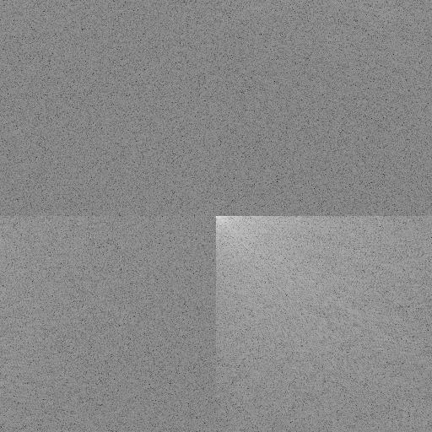
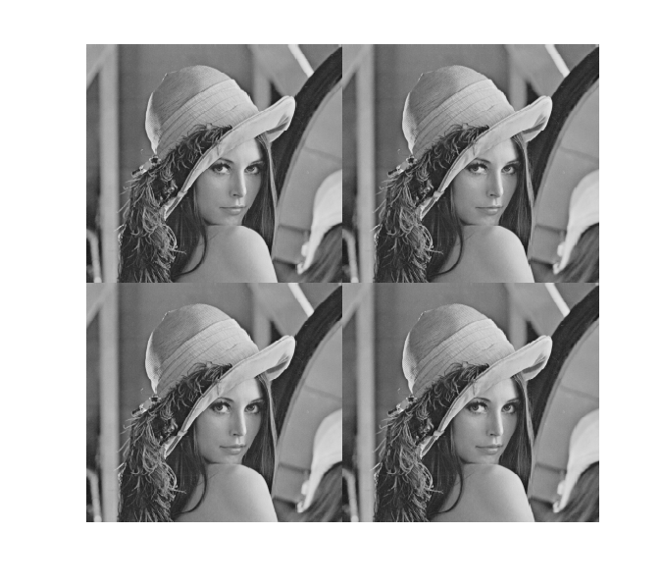
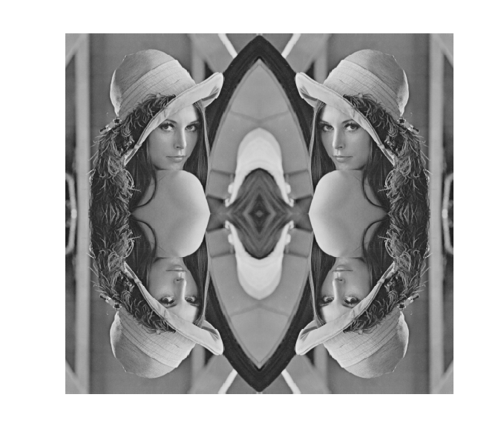
DFT and DCT
DFT2
DCT2
Shift low-freq to the center
Assume periodic and zero-padded …
Assume reflection …

Slide 42
Image Compression
Image compression is a method that reduces the amount of memory it takes to store in image.
We will exploit the fact that the DCT matrix is based on our visual system for the purpose of image compression.
This means we can delete the least significant values without our eyes noticing the difference.

Slide 43
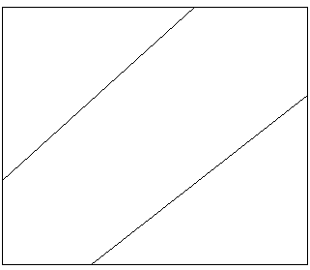
Image Compression
Now we have found the matrix Y = C(CX^{T})^{T}
Using the DCT, the entries in Y will be organized based on the human visual system.
The most important values to
our eyes will be placed in the
upper left corner of the matrix.
The least important values
will be mostly in the lower
right corner of the matrix.

Slide 44
Common Applications
JPEG Format
MPEG-1 and MPEG-2
MP3, Advanced Audio Coding, WMA
What’s in common?
  All share, in some form or another, a DCT method for compression.
Joint Photographic Experts Group

Slide 45
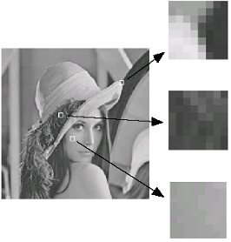
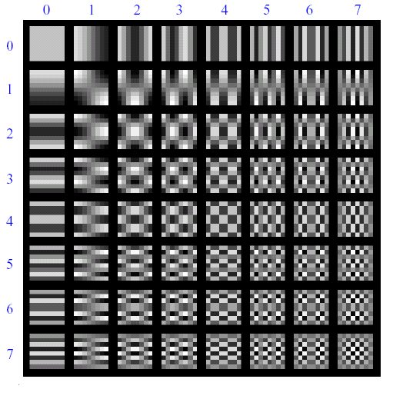
Lossy Image Compression (JPEG)
Block-based Discrete Cosine Transform (DCT)

Slide 46
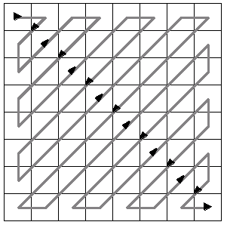
Using DCT in JPEG
The first coefficient B(0,0) is the DC component, the average intensity
The top-left coeffs represent low frequencies, the bottom right – high frequencies

Slide 47
Image compression using DCT
DCT enables image compression by concentrating most image information in the low frequencies
Loose unimportant image info (high frequencies)
The decoder computes the inverse DCT – IDCT

Slide 48
Block size in JPEG
Block size
  small block
    faster
    correlation exists between neighboring pixels
  large block
    better compression in smooth regions
  It’s 8x8 in standard JPEG

Slide 49
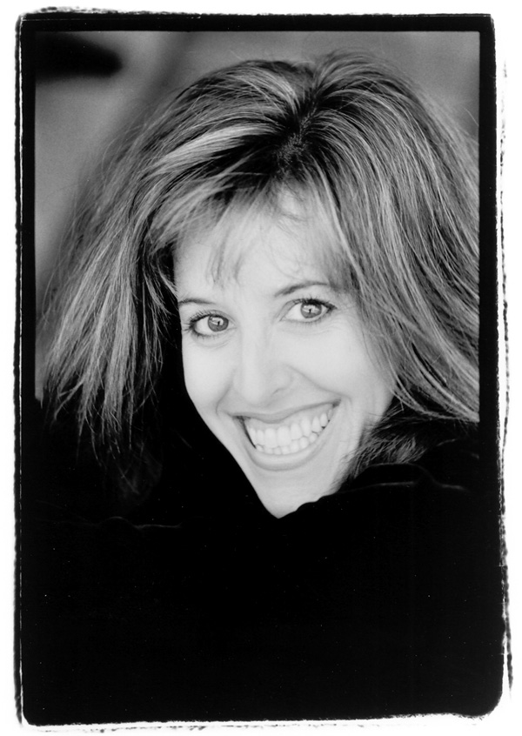
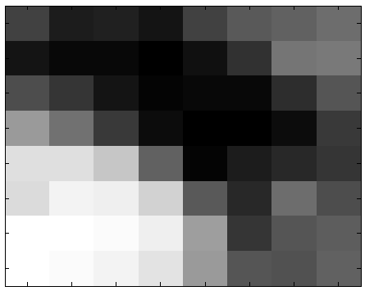
Image Compression
8 x 8 Pixels Image

Slide 50
Image Compression
Gray-Scale Example:
Value Range 0 (black) --- 255 (white)
63 33 36 28 63 81 86 98
27 18 17 11 22 48 104 108
72 52 28 15 17 16 47 77
132 100 56 19 10 9 21 55
187 186 166 88 13 34 43 51
184 203 199 177 82 44 97 73
211 214 208 198 134 52 78 83
211 210 203 191 133 79 74 86
X

Slide 51
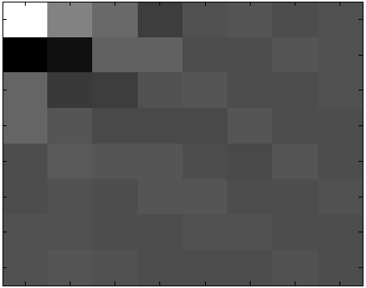
Image Compression
2D-DCT of matrix
-304 210 104 -69 10 20 -12 7
-327 -260 67 70 -10 -15 21 8
93 -84 -66 16 24 -2 -5 9
89 33 -19 -20 -26 21 -3 0
-9 42 18 27 -7 -17 29 -7
-5 15 -10 17 32 -15 -4 7
10 3 -12 -1 2 3 -2 -3
12 30 0 -3 -3 -6 12 -1
Numbers are coefficients of polynomial
Y

Slide 52
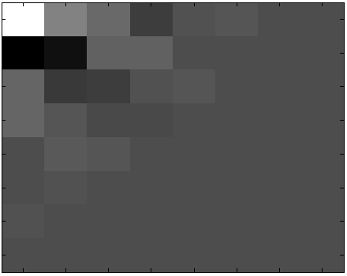
Image Compression
Cut the least significant components
-304 210 104 -69 10 20 -12 0
-327 -260 67 70 -10 -15 0 0
93 -84 -66 16 24 0 0 0
89 33 -19 -20 0 0 0 0
-9 42 18 0 0 0 0 0
-5 15 0 0 0 0 0 0
10 0 0 0 0 0 0 0
0 0 0 0 0 0 0 0
As you can see, we save a little over half the original memory.

Slide 53
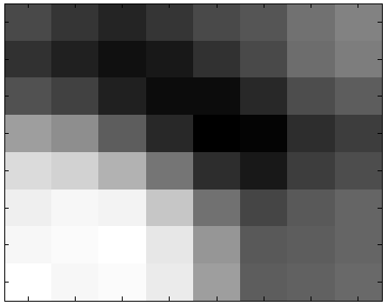
Reconstructing the Image
New Matrix and Compressed Image
55 41 27 39 56 69 92 106
35 22 7 16 35 59 88 101
65 49 21 5 6 28 62 73
130 114 75 28 -7 -1 33 46
180 175 148 95 33 16 45 59
200 206 203 165 92 55 71 82
205 207 214 193 121 70 75 83
214 205 209 196 129 75 78 85

Slide 54
Can You Tell the Difference?
Original Compressed

Slide 55
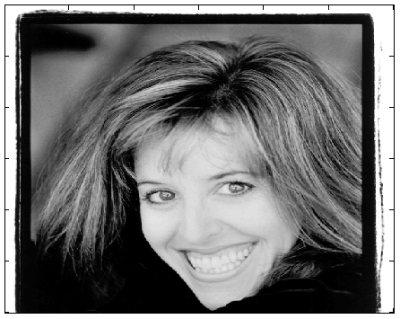
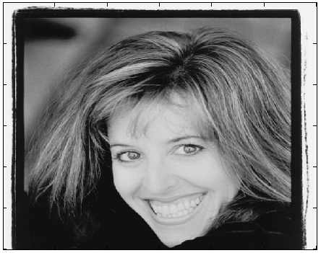
Image Compression
Original Compressed

Slide 56
Linear Quantization
We will not zero the bottom half of the matrix.
The idea is to assign fewer bits of memory to store information in the lower right corner of the DCT matrix.

Slide 57
Linear Quantization
Use Quantization Matrix (Q)
q_{kl} = 8p(k + l + 1) for 0 < k, l < 7
Q = p * 8 16 24 32 40 48 56 64
16 24 32 40 48 56 64 72
24 32 40 48 56 64 72 80
32 40 48 56 64 72 80 88
40 48 56 64 72 80 88 96
48 56 64 72 80 88 96 104
56 64 72 80 88 95 104 112
64 72 80 88 96 104 112 120

Slide 58
Linear Quantization
p is called the loss parameter
It acts like a “knob” to control compression
The greater p is the more you compress the image

Slide 59
Linear Quantization
We divide the each entry in the DCT matrix by the Quantization Matrix
-304 210 104 -69 10 20 -12 7
-327 -260 67 70 -10 -15 21 8
93 -84 -66 16 24 -2 -5 9
89 33 -19 -20 -26 21 -3 0
-9 42 18 27 -7 -17 29 -7
-5 15 -10 17 32 -15 -4 7
10 3 -12 -1 2 3 -2 -3
12 30 0 -3 -3 -6 12 -1
8 16 24 32 40 48 56 64
16 24 32 40 48 56 64 72
24 32 40 48 56 64 72 80
32 40 48 56 64 72 80 88
40 48 56 64 72 80 88 96
48 56 64 72 80 88 96 104
56 64 72 80 88 95 104 112
64 72 80 88 96 104 112 120

Slide 60
Linear Quantization
p = 1 p = 4
-38 13 4 -2 0 0 0 0
-20 -11 2 2 0 0 0 0
4 -3 -2 0 0 0 0 0
3 1 0 0 0 0 0 0
0 1 0 0 0 0 0 0
0 0 0 0 0 0 0 0
0 0 0 0 0 0 0 0
0 0 0 0 0 0 0 0
-9 3 1 -1 0 0 0 0
-5 -3 1 0 0 0 0 0
1 -1 0 0 0 0 0 0
1 0 0 0 0 0 0 0
0 0 0 0 0 0 0 0
0 0 0 0 0 0 0 0
0 0 0 0 0 0 0 0
0 0 0 0 0 0 0 0
0 0 0 0 0 0 0 0
New Y: 14 terms New Y: 10 terms

Slide 61
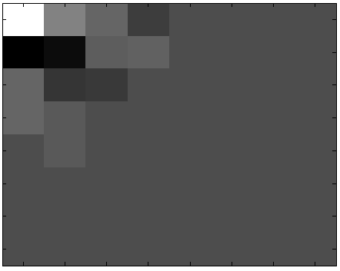
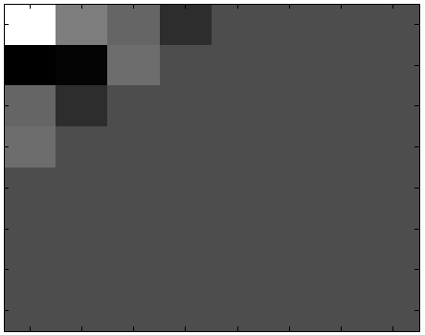
Linear Quantization
p = 1 p = 4

Slide 62


Linear Quantization
Compressed with P=1
Compressed with P=4

Slide 63
Linear Quantization
p = 1

Slide 64

Linear Quantization
P= 4

Slide 65

Quantization Example

Slide 66
Further Compression
Run-Length Encoding (RLE)
Huffman Coding

Slide 67
Memory Storage
The original image uses one byte (8 bits) for each pixel. Therefore, the amount of memory needed for each 8 x 8 block is:
  8 x (8²) = 512 bits

Slide 68
Is This Worth the Work?
The question that arises is “How much memory does this save?”
Linear Quantization
p | Total bits | Bits/pixel
X | 512 | 8
1 | 249 | 3.89
2 | 191 | 2.98
3 | 147 | 2.30

Slide 69
JPEG Imaging
It is fairly easy to extend this application to color images.
  These are expressed in the RGB color system.
  Each pixel is assigned three integers for each color intensity.

Slide 70

RGB Coordinates

Slide 71
The Approach
There are a few ways to approach the image compression.
  Repeat the discussed process independently for each of the three colors and then reconstruct the image.
  Baseline JPEG uses a more delicate approach.
    Define the luminance coordinate to be:
      Y = 0.299R + 0.587G + 0.114B
    Define the color differences coordinates to be:
      U = B – Y
      V = R – Y

Slide 72


More on Baseline
This transforms the RGB color data to the YUV system which is easily reversible.
It applies the DCT filtering independently to Y, U, and V using the quantization matrix Q_{Y}.
B
V
G
U
R
Y

Slide 73

JPEG Quantization
Luminance:
Q_{Y} =
p { 16 11 10 16 24 40 51 61
12 12 14 19 26 58 60 55
14 13 16 24 40 57 69 56
14 17 22 29 51 87 80 62
18 22 37 56 68 109 103 77
24 35 55 64 81 104 113 92
49 64 78 87 103 121 120 101
72 92 95 98 112 100 103 99}

Slide 74
JPEG Quantization
Chrominance:
Q_{C} =
{ 17 18 24 47 99 99 99 99
18 21 26 66 99 99 99 99
24 26 56 99 99 99 99 99
47 66 99 99 99 99 99 99
99 99 99 99 99 99 99 99
99 99 99 99 99 99 99 99
99 99 99 99 99 99 99 99
99 99 99 99 99 99 99 99}

Slide 75
Luminance and Chrominance
Human eye is more sensible to luminance
(Y coordinate).
It is less sensible to color changes
(UV coordinates).
Then: compress more on UV !
Consequence: color images are more compressible than grayscale ones

Slide 76
Reconstitution
After compression, Y, U, and V, are recombined and converted back to RGB to form the compressed color image:
B= U+Y
R= V+Y
G= (Y- 0.299R - 0.114B) / 0.587

Slide 77





Comparing Compression
Original
p = 1
p = 4
p = 8

Slide 78
Up Close

Slide 79


JPEG compression comparison
89k
12k
See also
https://en.wikipedia.org/wiki/JPEG

Slide 80
Wavelets - overview
Why wavelets?
Wavelets like basis components.
Wavelets examples.
Fast wavelet transform .
Wavelets like filter.
Wavelets advantages.

Slide 81


Fourier Analysis
Breaks down a signal into constituent sinusoids of different frequencies
In other words: Transform the view of the signal from time-base to frequency-base.

Slide 82
What’s wrong with Fourier?
By using Fourier Transform , we loose the time information : WHEN did a particular event take place ?
FT can not locate drift, trends, abrupt changes, beginning and ends of events, etc.
Calculating use complex numbers.

Slide 83
Time and Space definition
Time – for one dimension waves we start point shifting from source to end in time scale .
Space – for image point shifting is two dimensional .
Here they are synonyms .

Slide 84
Kronneker function
Can exactly show the time of appearance but have not information about frequency and shape of signal.

Slide 85


Short Time Fourier Analysis
In order to analyze small section of a signal, Denis Gabor (1946), developed a technique, based on the FT and using windowing : STFT

Slide 86
STFT (or: Gabor Transform)
A compromise between time-based and frequency-based views of a signal.
both time and frequency are represented in limited precision.
The precision is determined by the size of the window.
Once you choose a particular size for the time window - it will be the same for all frequencies.

Slide 87
What’s wrong with Gabor?
Many signals require a more flexible approach - so we can vary the window size to determine more accurately either time or frequency.

Slide 88

What is Wavelet Analysis ?
And…what is a wavelet…?
A wavelet is a waveform of effectively limited duration that has an average value of zero.

Slide 89
Wavelet's properties
Short time localized waves with zero integral value.
Possibility of time shifting.
Flexibility.

Slide 90
The Continuous Wavelet Transform (CWT)
A mathematical representation of the Fourier transform:
Meaning: the sum over all time of the signal f(t) multiplied by a complex exponential, and the result is the Fourier coefficients F() .

Slide 91

Wavelet Transform (Cont’d)
Those coefficients, when multiplied by a sinusoid of appropriate frequency , yield the constituent sinusoidal component of the original signal:

Slide 92

Wavelet Transform
And the result of the CWT are Wavelet coefficients .
Multiplying each coefficient by the appropriately scaled and shifted wavelet yields the constituent wavelet of the original signal:

Slide 93

Scaling
Wavelet analysis produces a time-scale view of the signal.
Scaling means stretching or compressing of the signal.
scale factor (a) for sine waves:

Slide 94

Scaling (Cont’d)
Scale factor works exactly the same with wavelets:

Slide 95

CWT

Slide 96
Wavelet function 1D -> 2D
(
)
b – shift coefficient
a – scale coefficient
2D function
Ψ
(
)
=
Ψ
−
1
x
b
a
,
b
x
a
a

Slide 97
CWT
Reminder: The CWT Is the sum over all time of the signal, multiplied by scaled and shifted versions of the wavelet function
Step 1:
Take a Wavelet and compare
it to a section at the start
of the original signal

Slide 98

CWT
Step 2:
Calculate a number, C, that represents how closely correlated the wavelet is
with this section of the signal. The
higher C indicates higher similarity.

Slide 99

CWT
Step 3: Shift the wavelet to the right and repeat steps 1-2 until you’ve covered the whole signal

Slide 100

CWT
Step 4: Scale (stretch) the wavelet and repeat steps 1-3

Slide 101
Wavelets examples
Dyadic transform
For easier calculation we can discretize a continuous signal.
We have a grid of discrete values that called dyadic grid .
Important: wavelet functions are compact (e.g. no overcalculatings) .

Slide 102



Haar Wavelets

Slide 103
Haar Wavelets Properties I
Any continuous real function with compact support can be approximated uniformly by linear combination of:
and their shifted functions

Slide 104
Haar Wavelets Properties II
Any continuous real function on [0, 1] can be approximated uniformly on [0, 1] by linear combinations of the constant function
and their shifted functions

Slide 105
Haar transform

Slide 106

Haar Wavelets Properties III
Orthogonality

Slide 107


Haar Wavelets Properties
Functional relationship:
It follows that coefficients of scale n can be calculated by
coefficients of scale n+1:

Slide 108





Haar Matrix

Slide 109

Wavelet functions examples
Haar function
Daubechies function

Slide 110
Properties of Daubechies wavelets
I. Daubechies, Comm. Pure Appl. Math. 41 (1988) 909.
Compact support
  finite number of filter parameters / fast implementations
  high compressibility
  fine scale amplitudes are very small in regions where the function is smooth / sensitive recognition of structures
Identical forward / backward filter parameters
  fast, exact reconstruction
  very asymmetric

Slide 111
Mallat* Filter Scheme
Mallat was the first to implement this scheme, using a well known filter design called “two channel sub band coder”, yielding a ‘Fast Wavelet Transform’

Slide 112
Approximations and Details:
Approximations: High-scale, low-frequency components of the signal
Details: low-scale, high-frequency components
LPF
Input Signal
HPF

Slide 113
Decimation
The former process produces twice the data it began with: N input samples produce N approximations coefficients and N detail coefficients.
To correct this, we Down sample (or: Decimate) the filter output by two, by simply throwing away every second coefficient.

Slide 114
Decimation (cont’d)
So, a complete one stage block looks like:
LPF
A*
Input Signal
HPF
D*

Slide 115

Multi-level Decomposition
Iterating the decomposition process, breaks the input signal into many lower-resolution components: Wavelet decomposition tree:

Slide 116

Wavelets and Pyramid
pyramid—each wavelet level stores 3/4
of the original pixels (usually the horizontal, vertical, and mixed gradients), so that the total
number of wavelet coefficients and original pixels is the same.

Slide 117


2D Wavelet Decomposition

Slide 118

2D Wavelet Decomposition

Slide 119


2D Wavelet transform

Slide 120

2D Wavelet transform

Slide 121

2D Wavelet transform – Jpeg2000

Slide 122
Orthogonality
For 2 vectors
For 2 functions

Slide 123
Why wavelets have orthogonal base ?
It easier calculation.
When we decompose some image and calculating zero level decomposition we have accurate values .
Scalar multiplication with other base function equals zero.

Slide 124

Wavelet reconstruction
Reconstruction (or synthesis) is the process in which we assemble all components back
Up sampling
(or interpolation) is done by zero inserting between every two coefficients

Slide 125
Wavelets like filters
Relationship of Filters to Wavelet Shape
Choosing the correct filter is most important.
The choice of the filter determines the shape of the wavelet we use to perform the analysis.

Slide 126

Example
A low-pass reconstruction filter (L’) for the db2 wavelet:
The filter coefficients (obtained by Matlab dbaux command:
0.3415 0.5915 0.1585 -0.0915
reversing the order of this vector and multiply every second coefficient by -1 we get the high-pass filter H’:
-0.0915 -0.1585 0.5915 -0.3415

Slide 127

Example (Cont’d)
Now we up-sample the H’ coefficient vector:
-0.0915 0 -0.1585 0 0.5915 0 -0.3415 0
and Convolving the up-sampled vector with the original low-pass filter we get:

Slide 128

Example (Cont’d)
Now iterate this process several more times, repeatedly up-sampling and convolving the resultant vector
with the original
low-pass filter,
a pattern
begins to
emerge:

Slide 129
Example: Conclusion
https://www.mathworks.com/examples/wavelet
The curve begins to look more like the db2 wavelet: the wavelet shape is determined entirely by the coefficient Of the reconstruction filter
You can’t choose an arbitrary wavelet waveform if you want to be able to reconstruct the original signal accurately!

Slide 130
Wavelets in Matlab
https://www.mathworks.com/examples/wavelet

Slide 131
Compression Example
A two dimensional (image) compression, using 2D wavelets analysis.
The image is a Fingerprint.
FBI uses a wavelet technique to compress its fingerprints database.

Slide 132

Fingerprint compression
Wavelet: Haar
Level:3

Slide 133

Results
Original Image Compressed Image
Threshold: 3.5
Zeros: 42%
Retained energy:
99.95%

Slide 134
Next Class
Principal Component Analysis
Geometric Transformations

