Slide 1
Stereo Matching by Training a Convolutional Neural Network to Compare Image Patches
Jure Zbontar, Yann LeCun

Slide 2
Table of Contents
Background
Motivation
Problem Formulation
Methodology
Training Data
Suggested Net Architectures
Sequential Steps
Results
Conclusion

Slide 3
Table of Contents
Background
Motivation
Problem Formulation
Methodology
Training Data
Suggested Net Architectures
Sequential Steps
Results
Conclusion

Slide 4
Motivation
Stereo Matching
Given input: 2 images (right and left), acquired at different horizontal positions
Required output: The disparity for each pixel in the left image
Disparity - difference in horizontal location (x-axis) of an object in the left and right image

Slide 5
Motivation
Stereo Matching

Slide 6
Motivation
Stereo Matching

Slide 7
Motivation
Applications
Given the disparity ‘ at each pixel, the depth a can be obtained by
- distance between camera centers
F - focal length
Applications in autonomous driving, robotics, 3D scene reconstruction and more…

Slide 8
Problem Formulation
Stereo Matching Steps
Stereo matching steps [Scharstein & Szeliski -2002]:
Matching cost computation
Cost aggregation
Optimization
Disparity refinement
Focus of this work: Matching cost initialization
Matching cost
initialization

Slide 9
Problem Formulation
Stereo Matching Steps
Matching cost example:
- Left and right image centered at q
- The set of locations within a fixed rectangular window centered at p

Slide 10
Problem Formulation
Goal
Matching cost initialization via convolutional neural networks

Slide 11
Table of Contents
Background
Motivation
Problem Formulation
Methodology
Training Data
Suggested Net Architectures
Sequential Steps
Results
Conclusion

Slide 12
Methodology
Training Data
Data sets: KITTI and Middlebury
For each image position with known disparity: one negative and one positive training example
Positive example: the right image patch center is shifted by $d−o_{pos}$ where $o_{pos}∈[0,ε]$
Negative example: the right image patch center is shifted by $d−o_{neg}$ where $o_{neg}∈±[δ_{l},δ_{h}]$

Slide 13
Methodology
Training Data
Example from KITTI dataset:
Example from Middlebury dataset:

Slide 14
Methodology
Training Data
Data augmentation procedure: Artificial expansion of the data set from existing samples
Tweak – small deviations between parallel image patches
Selected actions:
Rotation
Scaling
Horizontal scaling
Horizontal shearing
Horizontal transformation
Brightness & contrast adjustment

Slide 15
Methodology
Suggested Net Architectures
Two suggested architectures:
fast versus accurate
Common ground for both architectures:
Siamese network

Slide 16
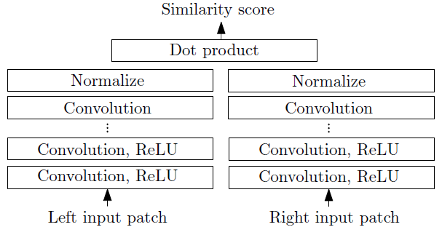
Methodology
Fast Architecture

Slide 17
Methodology
Fast Architecture
Training cost function – hinge loss
- margin
- net output for negative sample
- net output for positive sample
Similarity of the positive example is greater than the similarity of the negative example by at least the margin.

Slide 18
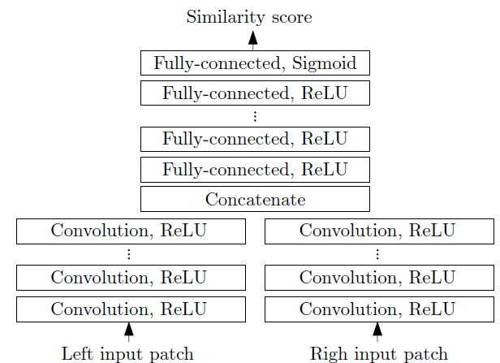
Methodology
Accurate Architecture

Slide 19
Methodology
Accurate Architecture
Training cost function – cross-entropy loss
- sample class
- net output

Slide 20
Methodology
Sequential Steps
Obtained matching cost
- patches from left and right images
Cross-based cost aggregation (CCBA) – Local averaging of matching cost
Semiglobal matching – Disparity map smoothness constraints enforcement
Disparity image computation and enhancement

Slide 21
Methodology
Key insights
The outputs of the two sub-networks need to be computed only once per location, and not for every disparity under consideration.
The output of the two sub-networks can be computed for all pixels in a single forward pass by propagating full-resolution images, instead of small image patches.
The fully connected layer forms the bottleneck.

Slide 22
Table of Contents
Background
Motivation
Problem Formulation
Methodology
Training Data
Suggested Net Architectures
Sequential Steps
Results
Conclusion

Slide 23
Results
Success Measure
Number of misclassified pixels
Total number of pixels

Slide 24
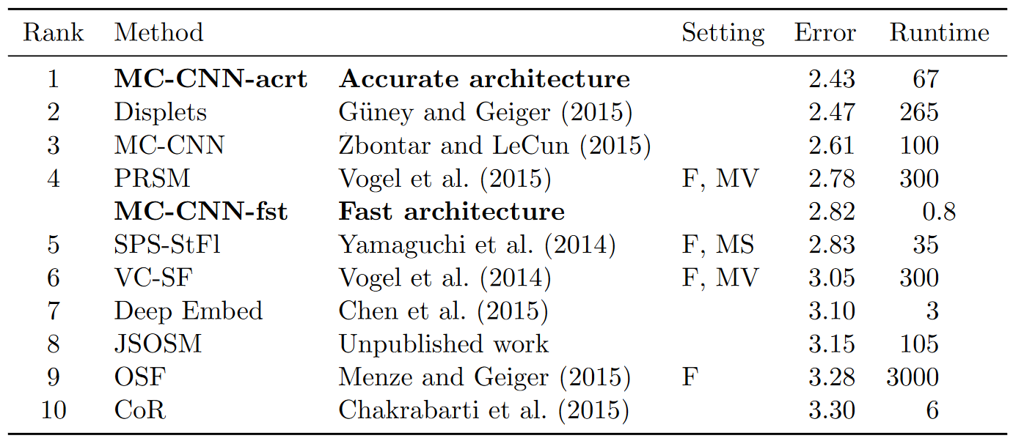
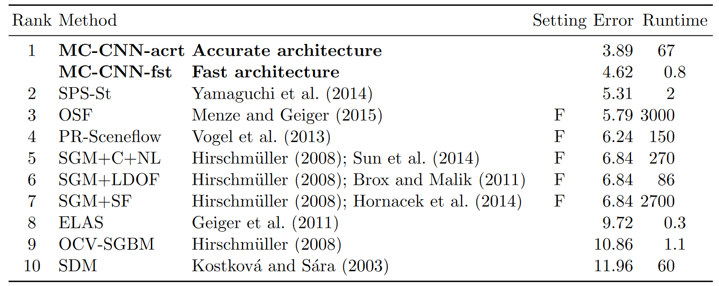
Results
KITTI2012 Dataset

Slide 25
Results
KITTI2015 Dataset

Slide 26
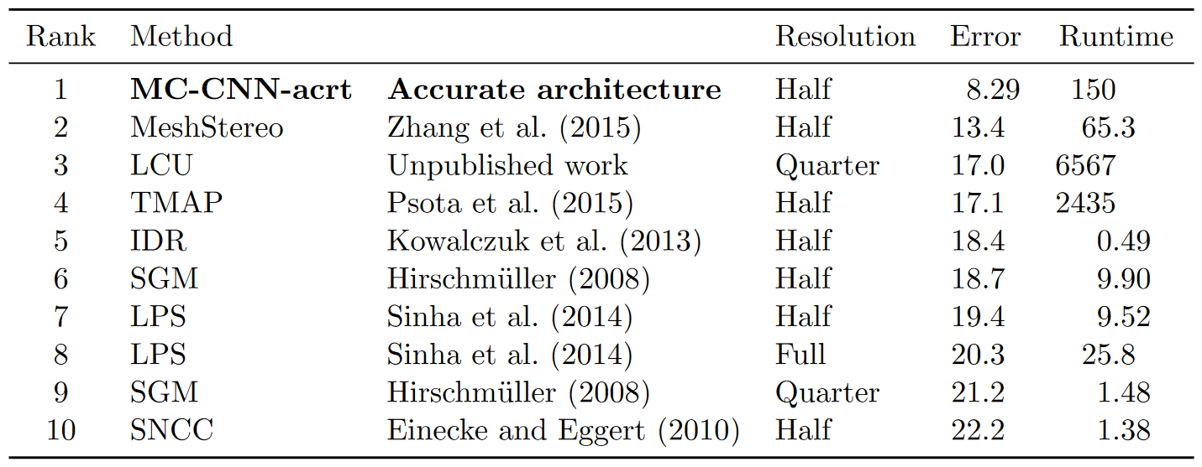
Results
Middlebury Dataset

Slide 27
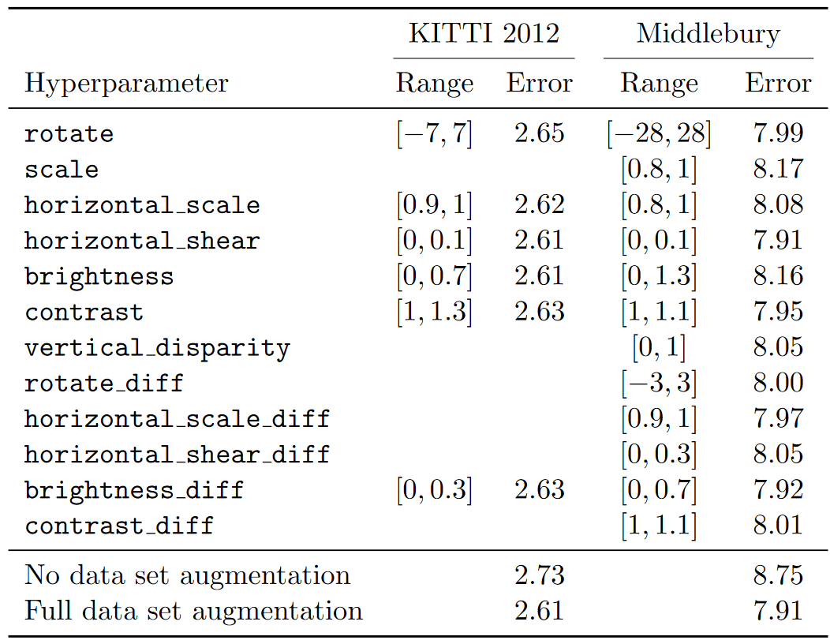
Results
Data Augmetntaion

Slide 28
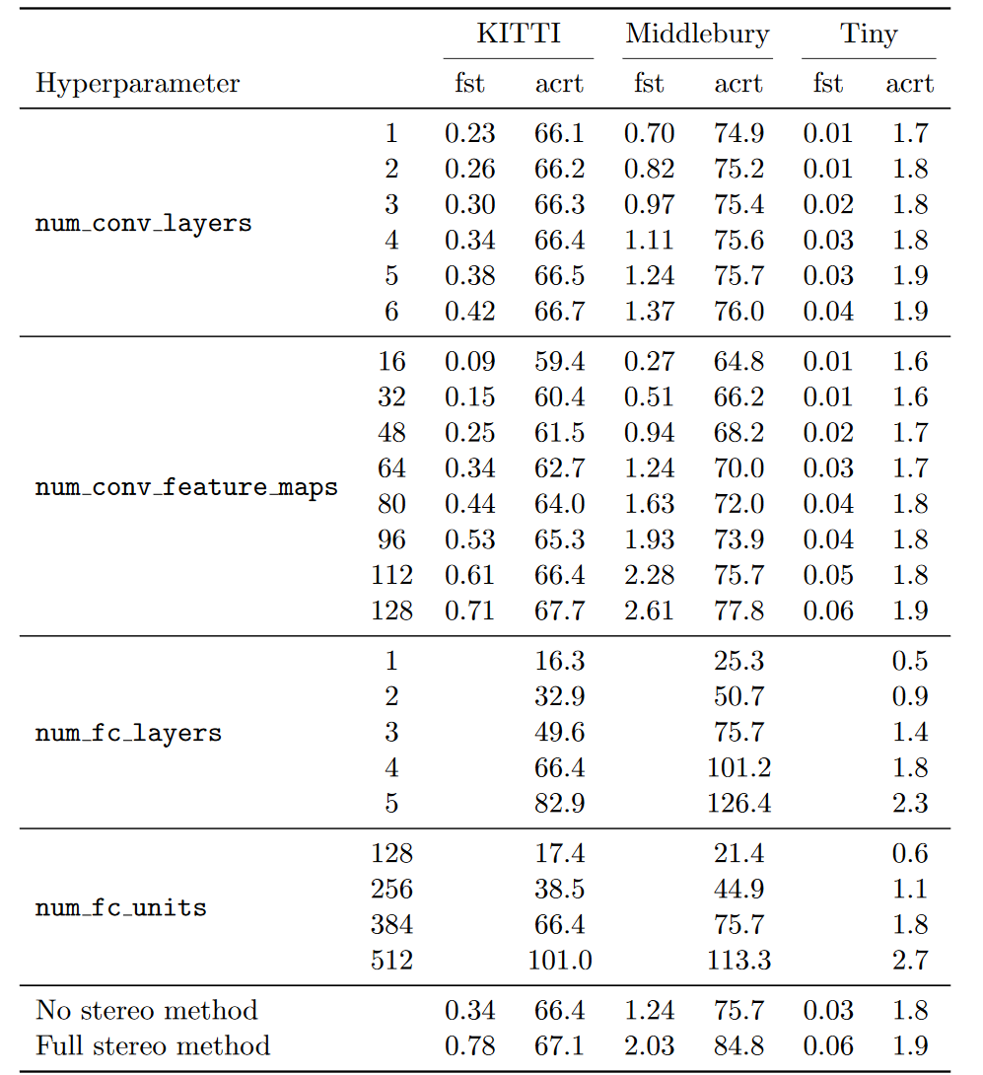
Results
Runtimes

Slide 29
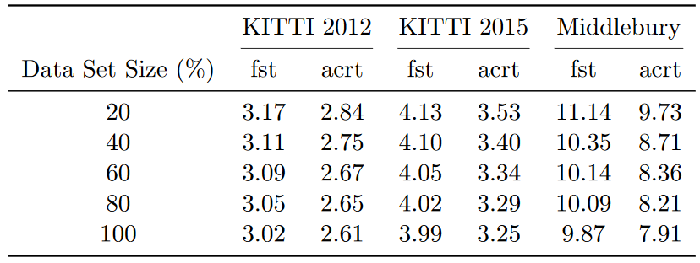
Results
Training Data Size

Slide 30
Results
Transfer Learning

Slide 31
Results
Hyperparameters
Remark: Patch size is directly determined by the number of convolutional layers

Slide 32
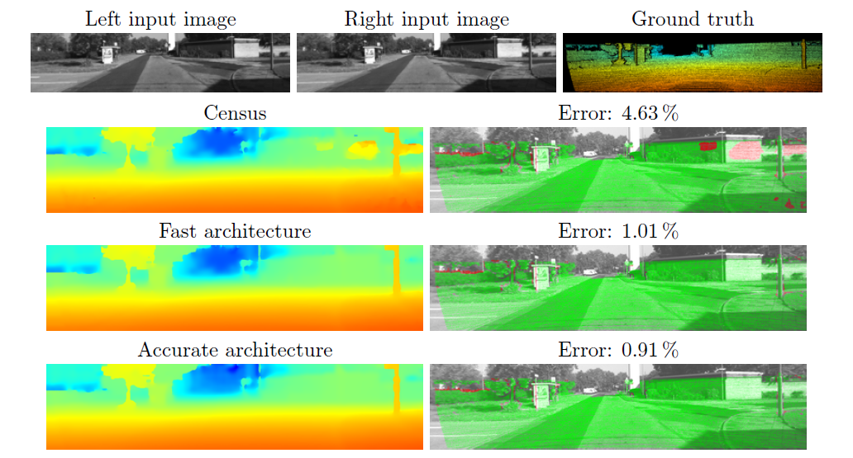
Results
Visual Examples (KITTI)

Slide 33
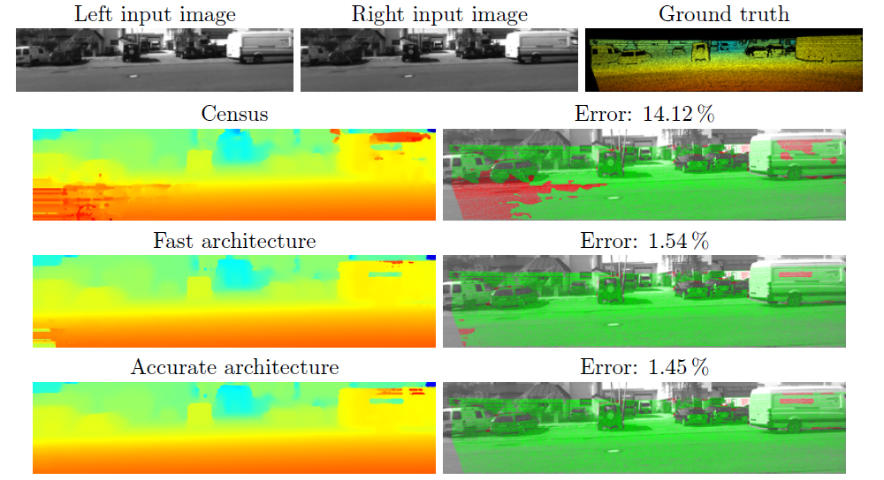
Results
Visual Examples (KITTI)

Slide 34
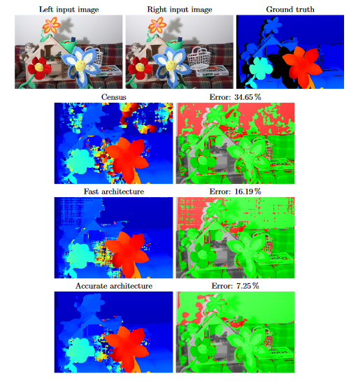
Results
Visual Examples (Middlebury)

Slide 35
Table of Contents
Background
Motivation
Problem Formulation
Methodology
Training Data
Suggested Net Architectures
Sequential Steps
Results
Conclusion

Slide 36
Conclusion
Two CNN architectures for learning a similarity measure on image patches were presented.
The two architectures were used for stereo matching.
A relatively simple CNN outperformed all previous methods on the well-studied problem of stereo.

