Slide 1
Deep Residual Learning for Image Recognition
Kaiming He
Xiangyu Zhang
Shaoqing Ren
Jian Sun
Microsoft Research

Slide 2
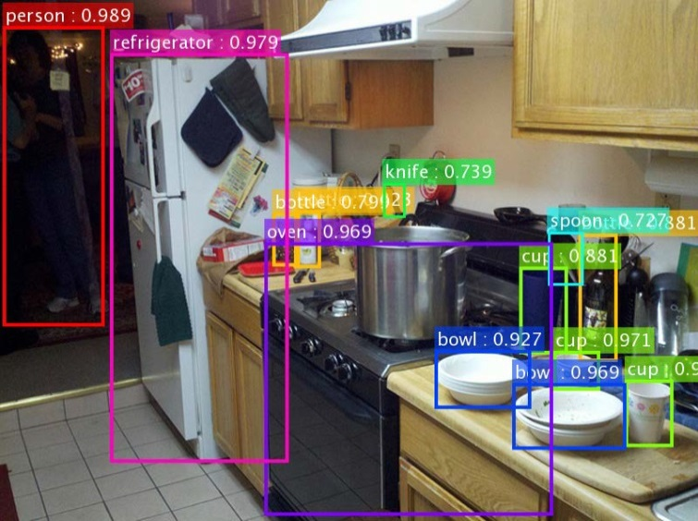
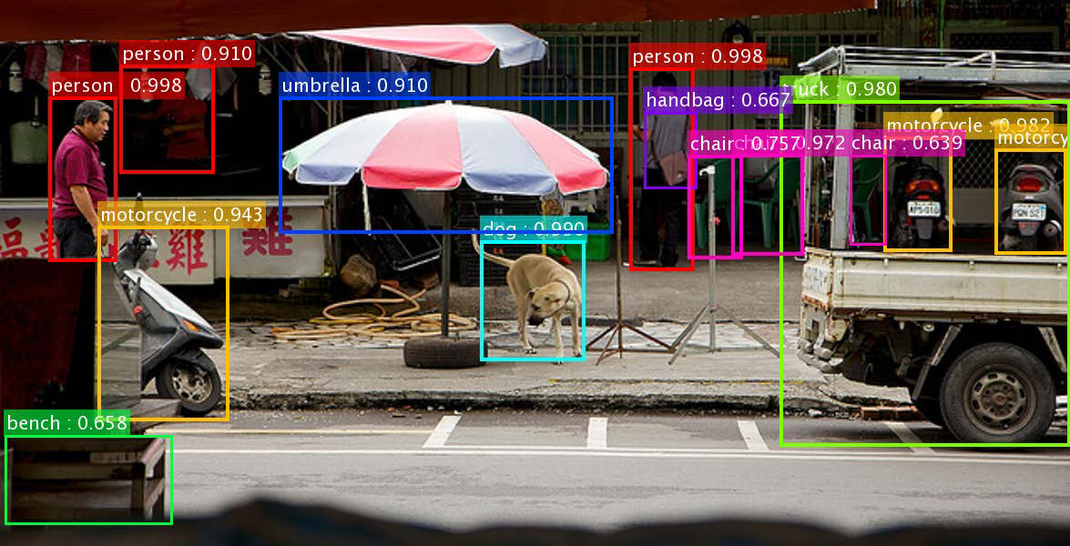
Challenge Winner(1)
80 Object Categories
More than 300,000 images
MS COCO -Detection

Slide 3
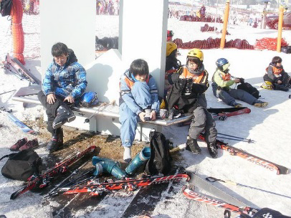
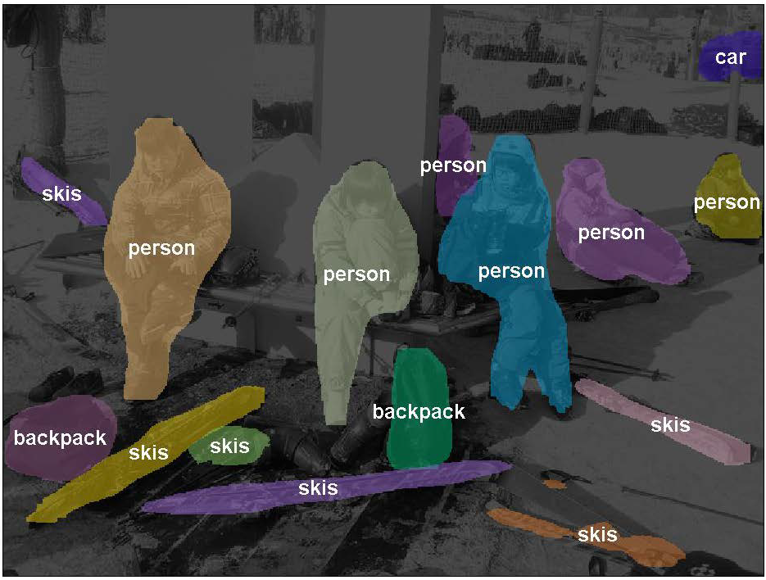
Challenge Winner(2)
MS COCO -Segmentation

Slide 4
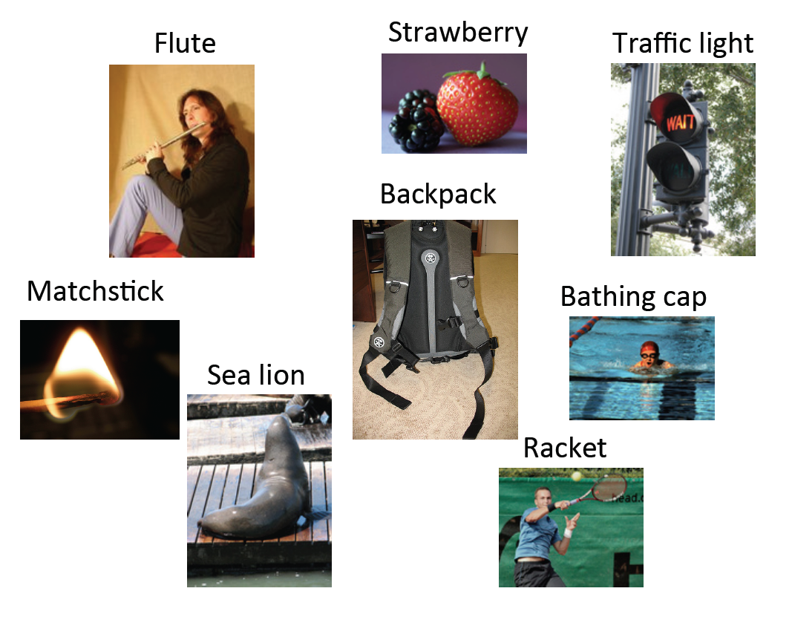
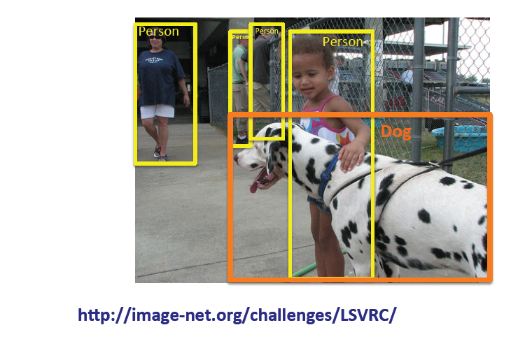
Challenge Winner(3)
ImageNet - Classification, Localization & Detection

Slide 5
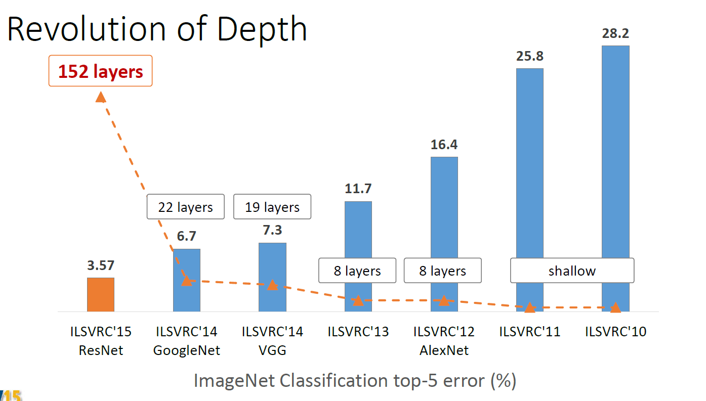
Advantages of Depth

Slide 6
Very Deep Networks
Two Similar approaches.
ResNet.
Highway Nets (R. K. Srivastava, K. Greff, and J. Schmidhuber. Highway networks.
arXiv:1505.00387, 2015.)

Slide 7
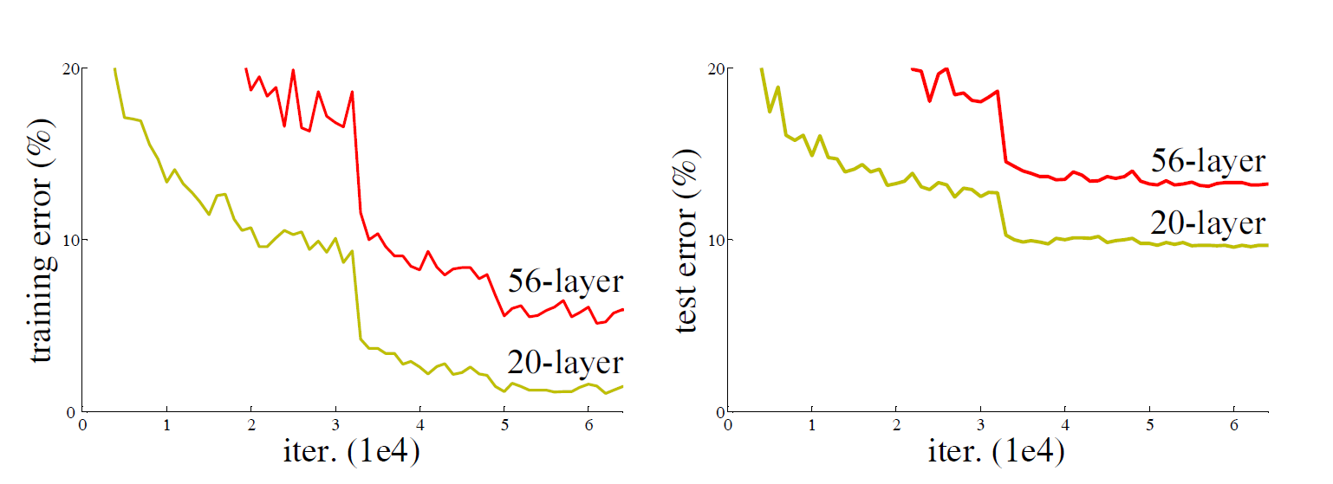
Degradation Problem

Slide 8
Possible Causes ?
Vanishing/Exploding Gradients.
Overfitting

Slide 9
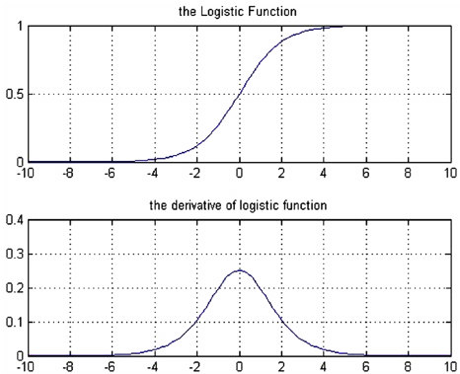
Vanishing/Exploding Gradients

Slide 10
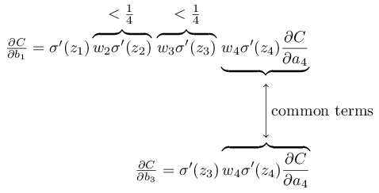
Vanishing Gradients
$${|σ′w}_{k}|<\frac{1}{4}$$
$${|w}_{k}|<1$$
Gradients in the first layer become very small
http://neuralnetworksanddeeplearning.com/

Slide 11
Exploding Gradients
$${|w}_{k}|=100$$
$${|σ′w}_{k}|≈25$$
Gradients in the first layer become very large
http://neuralnetworksanddeeplearning.com/

Slide 12
Batch Normalization(1)
Addresses the problem of vanishing/exploding gradients.
Increases learning speed and solves many other problems.
Each activation in every iteration each layer is normalized to have zero mean and variance 1 over a minibatch.
Integrated into back –propagation algorithm.

Slide 13
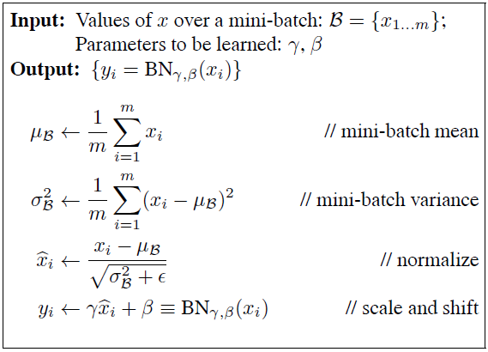
Batch Normalization(2)
S. Ioffe and C. Szegedy. Batch normalization: Accelerating deep
network training by reducing internal covariate shift. In ICML, 2015

Slide 14
BN solves vanishing Gradients(1)
$$z_{i}=σ(BN\left(Wz_{i−1}+b_{i}\right))$$
N$ow u is z:$
S. Ioffe and C. Szegedy. Batch normalization: Accelerating deep
network training by reducing internal covariate shift. In ICML, 2015

Slide 15
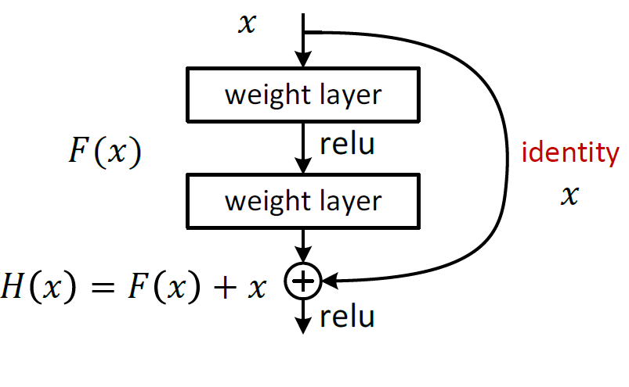
Residual Learning
2 weight layers fit F(X) = H(x) – X instead of F(X).
Networks might have “difficulties” fitting the unity mapping.

Slide 16
Similar Architecture – Highway Net
$$H(x,W_{H})$$
C$(x,W_{C})$
T$(x,W_{T})$
R. K. Srivastava, K. Greff, and J. Schmidhuber. Highway networks.
arXiv:1505.00387, 2015.
y

Slide 17
Highway Net vs. ResNet
The gates C and T are data dependent and have parameters.
When a gated shortcut is “closed” the layers in highway networks represent non-residual functions.
High-2 way networks have not demonstrated accuracy gains with depth of over 100 layers.
R. K. Srivastava, K. Greff, and J. Schmidhuber. Highway networks.
arXiv:1505.00387, 2015.

Slide 18
ResNet Design Rules
3 X3 Filters.
Same number of filters for same feature map size.
Feature Map Size halved
Number of Filters doubled
Almost no hidden max-pooling.
Not Hidden FC-Layers.
No Dropout.

Slide 19
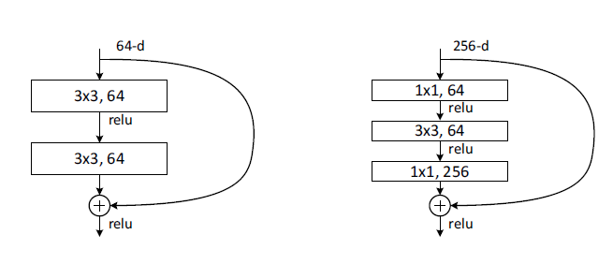
ResNet Buliding Blocks
Bottleneck Building Block
Building Blocks are stacked to create full networks.

Slide 20
ResNet and Plain Nets

Slide 21
ResNets Vs. PlainNets(1)
Deeper ResNets has lower train and test errors!

Slide 22
ResNets Vs. PlainNets(2)
Deeper ResNets has lower train and test errors!

Slide 23
ResNets Vs. PlainNets(3)
For 34 layers ResNet has a lower error.
For 18 layers error is roughly the same but convergence is faster.

Slide 24
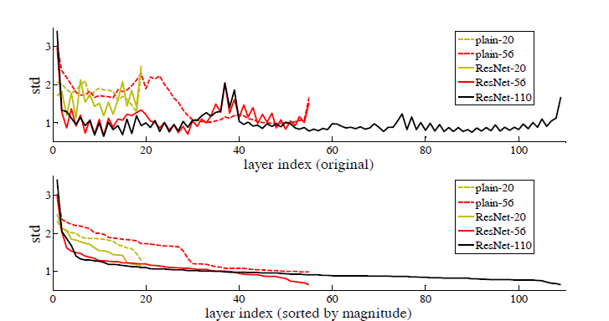
Layer Responses Magnitude
Responses of 3X3 layers before non-linearity and after BN.
Residual functions are closer to zero than non-residual.

Slide 25
Dimensionality Change
Shortcut connections assume dimension equality between input X and output F(x).
If dimensions do not match :
Zero Pad X
Projection mapping
(Extra Parameters)

Slide 26
Exploring Different Shortcuts Types
Three Options:
A - Zero padding for increasing dimensions.
B – Projection shortcuts for increasing dimensions; others are identity.
C – All shortcuts are projections.

Slide 27
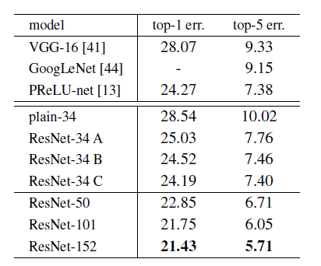
Overall Results

Slide 28
Uses For Image Detection and localization
Based on Faster RCNN architecture.
ResNet-101 architecture is used.
Obtained best results on MS-COCO, imageNet localization and imageNet Detection datasets.

Slide 29
Conclusions
Degradation problem is addressed for very deep NN.
No additional parameter complexity.
Faster convergence.
Good for different types of tasks.
Can be easily trained with existing solvers (Caffe, MatConvNet, etc…).
Sepp Hochreiter, presumably described the phenomena in 1991.

Slide 30
Bottleneck Architectures
Bottleneck building block with shortcut identity mapping.
Similar time complexity to non- bottleneck block.
50-layer, 101-layer and 152-layer ResNets were constructed.

Slide 31
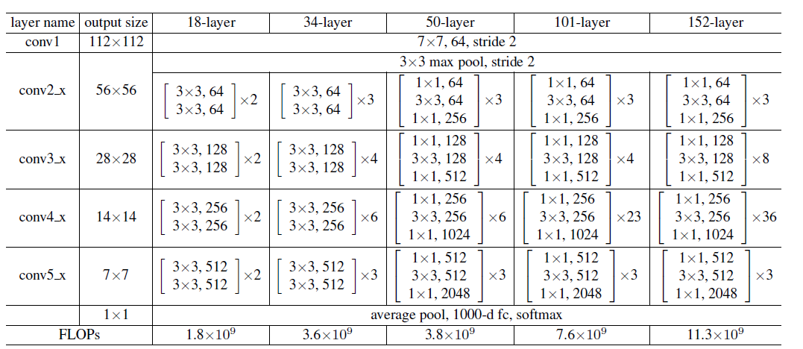
ResNet Implementation Details

Slide 32
Architectures For CIFAR-10
First layer is 3X3 convolutional.
6n layer stacked . 2n layers for each feature map.
Feature map size halved => number of filters doubled.
Only identity shortcuts are used.
Each pair of layers has a shortcut connection.

Slide 33
Localization and Detection Results
Detection:
Localization:

Slide 34
Results on detection MS-COCO

Slide 35
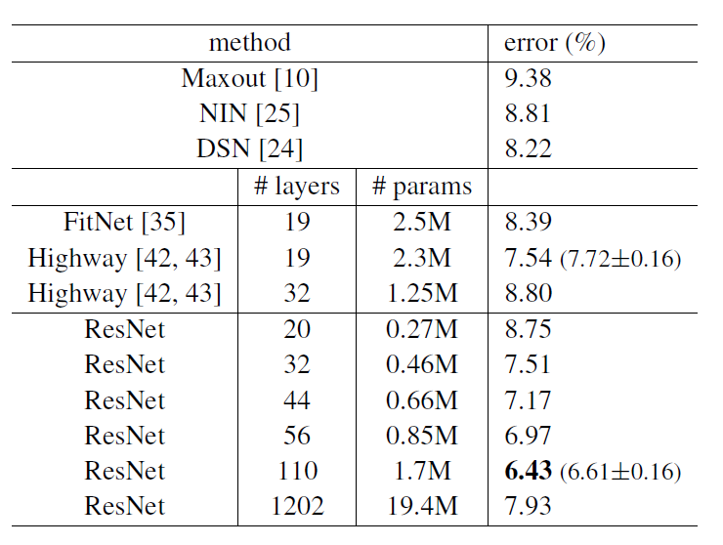
Overall Results CIFAR-10
ResNet-110 train five times and results are in the format of “best (mean ± std)”.
n= {3,5,7,9,18, 200}.
For 1202-layer net result degradation due to overfit.

Slide 36
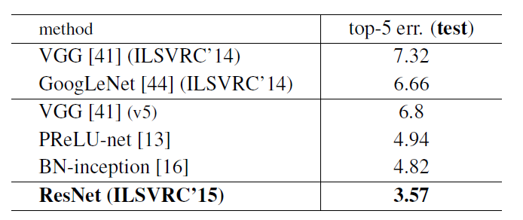
Overall Results ImageNet(2)

