Slide 1
Deep Residual Learning for Image Recognition
Ben Gurion University of the Negev
Deep Learning and its applications to Signal and Image Processing and Analysis
Aharon Kalantar, Ran Bezen, Maor Gaon
Some slides were adated/taken from various sources, including Andrew Ng’s Coursera lectures, CS231n: Convolutional Neural Networks for Visual Recognition lectures

Slide 2
In this Lecture
Introducing a breakthrough neural networks architecture introduced on 2015.
Why deep?
What’s the problem in learning deep networks?
ResNet and how it allow us to gain more performance via deeper networks.
Some results, improvements and farther works.
Intro
ResNet
Technical details
Results
ResNet 1000
Comparison

Slide 3
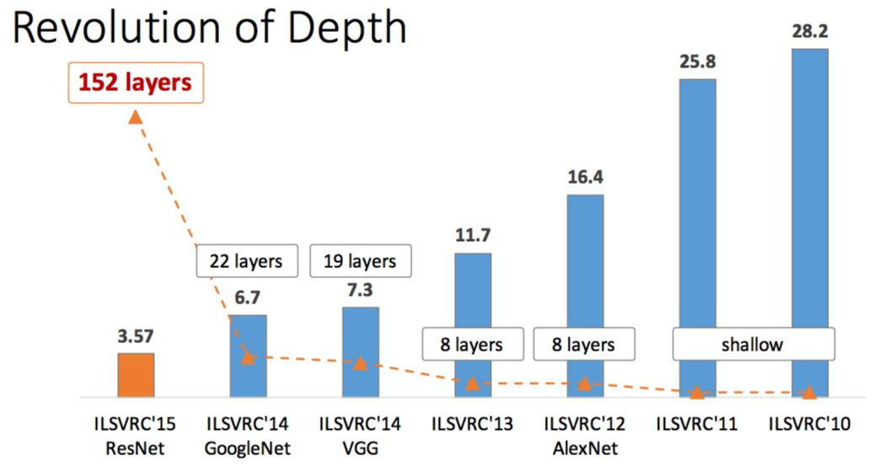
ImageNet Large Scale Visual Recognition Challenge (ILSVRC) winners
Intro
ResNet
Technical details
Results
ResNet 1000
Comparison

Slide 4
Deep vs Shallow Networks
What happens when we continue stacking deeper layers on a “plain” convolutional
neural network?
56-layer
56-layer
Training error
Test error
20-layer
20-layer
Iterations
Iterations
56-layer model performs worse on both training and test error
-> The deeper model performs worse, but it’s not caused by overfitting!
Intro
ResNet
Technical details
Results
ResNet 1000
Comparison
Notes:
שמראה שככל ששכבות הולכות ועולות אנו לא בהכרך מקבלים תוצאות טובות יותר, ראינו את זה בטסט וחשבנו שזה התאמת יתר (overfitting) בפועל זה הוצג גם בטראייניג ולכן הבנו שישנה בעיה – הבעיה נובעת כתוצאה מהתכנסות של הגרדיאנטים vanishing gradient,
מכוון שהבעיה קיימת גם בסט אימון – אין טעם להשתמש בטכניקות רגולריזציה כמו dropout
לכן ישנו צורך בלחשוב על ארכיטקטורה שונה שתמנע את בעיית ההתכנסות

Slide 5
Deeper models are harder to optimize
The deeper model should be able to perform at least as well as the shallower model.
A solution by construction is copying the learned layers from the shallower model and setting additional layers to identity mapping.
Intro
ResNet
Technical details
Results
ResNet 1000
Comparison

Slide 6
Challenges
Deeper Neural Networks start to degrade in performance.
Vanish/Exploding Gradient – May lead for extremely complex parameters initializations to make it work. Still might suffer from Vanish/Exploding even for the best parameters.
Long training times – Due to too many training parameters.
Intro
ResNet
Technical details
Results
ResNet 1000
Comparison

Slide 7
Partial Solutions for Vanish/Exploding gradients
Batch Normalization – To rescale the weights over some batch.
Smart Initialization of weights – Like for example Xavier initialization.
Train portions of the network individually.
Intro
ResNet
Technical details
Results
ResNet 1000
Comparison

Slide 8
Related Prior Work - Highway networks
Adding features from previous time steps has been used in various tasks
Most notable of these are Highway networks proposed by Srivastava et al.
Highway networks feature residual connections Residual networks have the form
Y = f(x ) + x
Highway networks have the form
Y = f(x )sigmoid(Wx + b) + x(1 —sigmoid (Wx + b))
Intro
ResNet
Technical details
Results
ResNet 1000
Comparison
Notes:
https://arxiv.org/pdf/1505.00387.pdf -
Residual networks - No additional complexity nor more parameters – by default will prefer to flow the input – need to be really convinced to stop the influence of the input by learning the last Relu weights, Could easily be convinced to use them on later iteration.
Highway – using gate can skip the learning the residual, could decide at some point that it should stop flowing the input but this input might have been really useful on deeper layers, add an heavy impact on performance by introducing many more weights to learn.

Slide 9
Highway networks – cont.
Highway networks enabled information flow from the past but due to the gating function
Intro
ResNet
Technical details
Results
ResNet 1000
Comparison
Notes:
Highway networks enabled information flow from the past but due to the gating function, the flow of information can still be impeded.
In addition increase immensely the amount of learning parameters.

Slide 10
ResNet
A specialized network introduced by Microsoft.
Connects inputs of layers into farther part of that network to allow “shortcuts”.
Simple idea – great improvements with both performance and train time.
Intro
ResNet
Technical details
Results
ResNet 1000
Comparison

Slide 11
Plain Network
$$a^{[l+1]}$$
$$a^{[l]}$$
$$a^{[l+2]}$$
$$z^{[l+1]}{=W}^{[l+1]}a^{[l]}+b^{[l+1]}$$
“linear”
$$a^{[l+1]}=g(z^{[l+1]})$$
“relu”
$$z^{[l+2]}= W^{[l+2]}a^{[l+1]}+b^{[l+2]}$$
“output”
$$a^{[l+2]}=g\left(z^{\left[l+2\right]}\right)$$
“relu on output”
Intro
ResNet
Technical details
Results
ResNet 1000
Comparison

Slide 12
Residual Blocks
$$a^{[l+1]}$$
$$a^{[l]}$$
$$a^{[l+2]}$$
$$z^{[l+1]}{=W}^{[l+1]}a^{[l]}+b^{[l+1]}$$
“linear”
$$a^{[l+1]}=g(z^{[l+1]})$$
“relu”
$$z^{[l+2]}= W^{[l+2]}a^{[l+1]}+b^{[l+2]}$$
“output”
$$a^{[l+2]}=g\left(z^{\left[l+2\right]}+a^{\left[l\right]}\right)$$
“relu on output plus input”
Intro
ResNet
Technical details
Results
ResNet 1000
Comparison

Slide 13
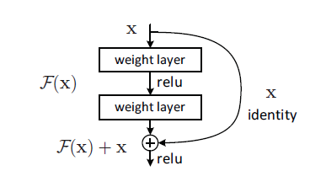
Skip Connections “shortcuts”
Such connections are referred as skipped connections or shortcuts. In general similar models could skip over several layers.
They refer to residual part of the network as a unit with input and output.
Such residual part receives the input as an amplifier to its output – The dimensions usually are the same.
Another option is to use a projection to the output space.
Either way – no additional training parameters are used.
Intro
ResNet
Technical details
Results
ResNet 1000
Comparison
Notes:
Such connections are referred as skipped connections or shortcuts. In general similar models could skip over several layers.
They refer to residual part of the network as a unit with input and output.
Such residual part receives the input as an amplifier to its output – The dimensions usually are the same.
Another option is to use a projection to the output space.
Either way – no additional training parameters are used.

Slide 14
The new model
Referring the original residual function as H$\left(x\right)$.
The residual parts now fits a new function $F(x)=H\left(x\right)−x$.
The original mapping is recast into $H\left(x\right)+x$.
The hypothesis of this research is that it is easier to learn $F(x)$.
Theoretically the problems are equivalent.
Intro
ResNet
Technical details
Results
ResNet 1000
Comparison

Slide 15
ResNet as a ConvNet
Till now we talked about fully connected layers.
The ResNet idea could easily expended into convolutional model.
Other adaptations of this idea could be easily introduced to almost any kind of deep layered network.
Intro
ResNet
Technical details
Results
ResNet 1000
Comparison

Slide 16
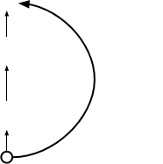
ResNet Architecture
Softmax
FC 1000
Pool
3x3 conv, 512
3x3 conv, 512
3x3 conv, 512
Full ResNet architecture:
3x3 conv, 512
-
Stack residual blocks
relu
3x3 conv, 512
F(x) + x
3x3 conv, 512, /2
-
Every residual block has
..
two 3x3 conv layers
.
3x3 conv
3x3 conv, 128
3x3 conv, 128
F(x)
X
3x3 conv, 128
relu
identity
3x3 conv, 128
3x3 conv
3x3 conv, 128
3x3 conv, 128, / 2
3x3 conv, 64
3x3 conv, 64
X
3x3 conv, 64
Residual block
3x3 conv, 64
3x3 conv, 64
3x3 conv, 64
Pool
7x7 conv, 64, / 2
Input
Intro
ResNet
Technical details
Results
ResNet 1000
Comparison

Slide 17
ResNet Architecture
Softmax
FC 1000
Pool
3x3 conv, 512
3x3 conv, 512
3x3 conv, 512
Full ResNet architecture:
3x3 conv, 512
-
Stack residual blocks
relu
3x3 conv, 512
F(x) + x
3x3 conv, 512, /2
-
Every residual block has
..
two 3x3 conv layers
.
-
Periodically, double # of
3x3 conv
3x3 conv, 128
3x3 conv, 128
3x3 conv, 128
filters and downsample
F(x)
X
3x3 conv, 128
filters, /2
relu
identity
3x3 conv, 128
spatially using stride 2
spatially with
3x3 conv
3x3 conv, 128
stride 2
(/2 in each dimension)
3x3 conv, 128, / 2
3x3 conv, 64
3x3 conv, 64
3x3 conv, 64
filters
X
3x3 conv, 64
Residual block
3x3 conv, 64
3x3 conv, 64
3x3 conv, 64
Pool
7x7 conv, 64, / 2
Input
Intro
ResNet
Technical details
Results
ResNet 1000
Comparison

Slide 18
ResNet Architecture
Softmax
FC 1000
Pool
3x3 conv, 512
3x3 conv, 512
3x3 conv, 512
Full ResNet architecture:
3x3 conv, 512
-
Stack residual blocks
relu
3x3 conv, 512
F(x) + x
3x3 conv, 512, /2
-
Every residual block has
..
two 3x3 conv layers
.
-
Periodically, double # of
3x3 conv
3x3 conv, 128
3x3 conv, 128
filters and downsample
F(x)
X
3x3 conv, 128
relu
identity
3x3 conv, 128
spatially using stride 2
3x3 conv
3x3 conv, 128
(/2 in each dimension)
3x3 conv, 128, / 2
-
Additional conv layer at
3x3 conv, 64
3x3 conv, 64
the beginning
X
3x3 conv, 64
Residual block
3x3 conv, 64
3x3 conv, 64
3x3 conv, 64
Pool
Beginning
7x7 conv, 64, / 2
Input
conv layer
Intro
ResNet
Technical details
Results
ResNet 1000
Comparison

Slide 19
ResNet Architecture
Softmax
No FC layers
FC 1000
Pool
besides FC
3x3 conv, 512
1000 to
3x3 conv, 512
output
classes
3x3 conv, 512
Full ResNet architecture:
3x3 conv, 512
Global
-
Stack residual blocks
relu
3x3 conv, 512
average
F(x) + x
3x3 conv, 512, /2
pooling layer
-
Every residual block has
..
after last
two 3x3 conv layers
.
conv layer
-
Periodically, double # of
3x3 conv
3x3 conv, 128
3x3 conv, 128
filters and downsample
F(x)
X
3x3 conv, 128
relu
identity
3x3 conv, 128
spatially using stride 2
3x3 conv
3x3 conv, 128
(/2 in each dimension)
3x3 conv, 128, / 2
-
Additional conv layer at
3x3 conv, 64
3x3 conv, 64
the beginning
X
3x3 conv, 64
-
No FC layers at the end
Residual block
3x3 conv, 64
3x3 conv, 64
(only FC 1000 to output
3x3 conv, 64
classes)
Pool
7x7 conv, 64, / 2
Input
Intro
ResNet
Technical details
Results
ResNet 1000
Comparison

Slide 20
ResNet Architecture
Softmax
FC 1000
Pool
3x3 conv, 512
3x3 conv, 512
3x3 conv, 512
3x3 conv, 512
3x3 conv, 512
Total depths of 34, 50, 101, or
3x3 conv, 512, /2
152 layers for ImageNet
..
.
3x3 conv, 128
3x3 conv, 128
3x3 conv, 128
3x3 conv, 128
3x3 conv, 128
3x3 conv, 128, / 2
3x3 conv, 64
3x3 conv, 64
3x3 conv, 64
3x3 conv, 64
3x3 conv, 64
3x3 conv, 64
Pool
7x7 conv, 64, / 2
Input
Intro
ResNet
Technical details
Results
ResNet 1000
Comparison

Slide 21
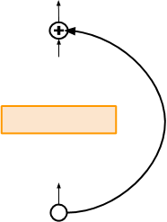
ResNet Architecture
28x28x256
output
For deeper networks
1x1 conv, 256
(ResNet-50+), use “bottleneck”
layer to improve efficiency
3x3 conv, 64
(similar to GoogLeNet)
1x1 conv, 64
28x28x256
input
Intro
ResNet
Technical details
Results
ResNet 1000
Comparison

Slide 22
ResNet Architecture
28x28x256
output
1x1 conv, 256 filters projects
back to 256 feature maps
For deeper networks
(28x28x256)
1x1 conv, 256
(ResNet-50+), use “bottleneck”
layer to improve efficiency
3x3 conv operates over
only 64 feature maps
3x3 conv, 64
(similar to GoogLeNet)
1x1 conv, 64 filters
1x1 conv, 64
to project to
28x28x64
28x28x256
input
Intro
ResNet
Technical details
Results
ResNet 1000
Comparison
Notes:
http://ethereon.github.io/netscope/#/gist/db945b393d40bfa26006

Slide 23
Residual Blocks (skip connections)
Notes:
[He et al., 2015. Deep residual networks for image recognition]
Example network architectures for ImageNet. Left: the
VGG-19 model [41] (19.6 billion FLOPs) as a reference. Middle:
a plain network with 34 parameter layers (3.6 billion FLOPs).
Right: a residual network with 34 parameter layers (3.6 billion
FLOPs). The dotted shortcuts increase dimensions. Table 1 shows
more details and other variants.

Slide 24
Deeper Bottleneck Architecture
Intro
ResNet
Technical details
Results
ResNet 1000
Comparison

Slide 25
Deeper Bottleneck Architecture (Cont.)
Addresses high training time of very deep networks.
Keeps the time complexity same as the two layered convolution
Allows us to increase the number of layers
allows the model to converge much faster.
152-layer ResNet has 11.3 billion FLOPS while VGG-16/19 nets has 15.3/19.6 billion FLOPS.
Intro
ResNet
Technical details
Results
ResNet 1000
Comparison
Notes:
Addresses high training time of very deep networks.
Keeps the time complexity same as the two layered convolution. (As long as identity short-cut are used and not projection mapping)
Allows us to increase the number of layers while keeping the layer as economic as possible.
Doe not introduce any theoretically change, but in practice allows the model to converge much faster.
152-layer ResNet has 11.3 billion FLOPS while VGG-16/19 nets has 15.3/19.6 billion FLOPS.

Slide 26
Why Do ResNets Work Well?
Having a “regular” network that is very deep might actually hurt performance because of the vanishing and exploding gradients
In most cases, ResNets will simply stop improving rather then decrease in performance
$a^{[l+2]}=g\left(z^{\left[l+2\right]}+a^{\left[l\right]}\right)=g(w^{\left[l+1\right]}a^{\left[l+1\right]}+b^{\left[l\right]}+a^{[l]})$
If the layer is not “useful”, L2 regularization will bring it’s parameters very close to zero, resulting in${ a}^{[l+2]}=g\left(a^{[l]}\right)=a^{[l]}$ (when using ReLU)
Intro
ResNet
Technical details
Results
ResNet 1000
Comparison
Notes:
Mention that the gradients are evenly split and summed in layer l

Slide 27
Why Do ResNets Work Well? (Cont)
In theory ResNet is still identical to plain networks, but in practice due to the above the convergence is much faster.
No additional training parameters introduced.
No addition complexity introduced.
Intro
ResNet
Technical details
Results
ResNet 1000
Comparison

Slide 28
Training ResNet in practice
Batch Normalization after every CONV layer.
Xavier/2 initialization from He et al.
SGD + Momentum (0.9)
Learning rate: 0.1, divided by 10 when validation error plateaus.
Mini-batch size 256.
Weight decay of 1e-5.
No dropout used.
Intro
ResNet
Technical details
Results
ResNet 1000
Comparison

Slide 29
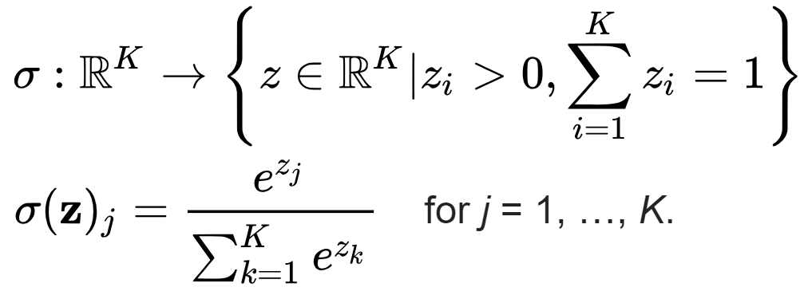
Loss Function
For measuring the loss of the model a combination of cross-entropy and softmax were used.
The output of the cross-entropy was normalized using softmax function.
Intro
ResNet
Technical details
Results
ResNet 1000
Comparison

Slide 30
Results
Experimental Results
-
Able to train very deep
networks without degrading
(152 layers on ImageNet, 1202
on Cifar)
-
Deeper networks now achieve
lowing training error as
expected
-
Swept 1st place in all ILSVRC
and COCO 2015 competitions
ILSVRC 2015 classification winner (3.6%
top 5 error) -- better than “human
performance”! (Russakovsky 2014)
Intro
ResNet
Technical details
Results
ResNet 1000
Comparison
Notes:
Todays (2018) state of the art stands on “Squeeze-and-Excitation Networks” paper released on April 5 2018!

Slide 31
Comparing Plain to ResNet (18/34 Layers)
Intro
ResNet
Technical details
Results
ResNet 1000
Comparison

Slide 32
Comparing Plain to Deeper ResNet
Test Error:
Train Error:
Intro
ResNet
Technical details
Results
ResNet 1000
Comparison
Notes:
Training on CIFAR-10. Dashed lines denote training error, and bold lines denote testing error. Left: plain networks. The error
of plain-110 is higher than 60% and not displayed. Middle: ResNets. Right: ResNets with 110 and 1202 layers.

Slide 33
ResNet on More than 1000 Layers
To farther improve learning of extremely deep ResNet “Identity Mappings in Deep Residual Networks Kaiming He, Xiangyu Zhang, Shaoqing Ren, and Jian Sun 2016” suggests to pass the input directly to the final residual layer, hence allowing the network to easily learn to pass the input as identity mapping both in forward and backward passes.
Intro
ResNet
Technical details
Results
ResNet 1000
Comparison
Notes:
Left: (a) original Residual Unit in [1]; (b) proposed Residual Unit. The grey
arrows indicate the easiest paths for the information to propagate, corresponding to
the additive term \xl" in Eqn.(4) (forward propagation) and the additive term \1" in
Eqn.(5) (backward propagation). Right: training curves on CIFAR-10 of 1001-layer
ResNets. Solid lines denote test error (y-axis on the right), and dashed lines denote
training loss (y-axis on the left). The proposed unit makes ResNet-1001 easier to train.

Slide 34
Identity Mappings in Deep Residual Networks
Intro
ResNet
Technical details
Results
ResNet 1000
Comparison
Notes:
Left: (a) original Residual Unit in [1]; (b) proposed Residual Unit. The grey
arrows indicate the easiest paths for the information to propagate, corresponding to
the additive term \xl" in Eqn.(4) (forward propagation) and the additive term \1" in
Eqn.(5) (backward propagation). Right: training curves on CIFAR-10 of 1001-layer
ResNets. Solid lines denote test error (y-axis on the right), and dashed lines denote
training loss (y-axis on the left). The proposed unit makes ResNet-1001 easier to train.

Slide 35
Identity Mappings in Deep Residual Networks
To construct identity mapping $f\left(y_{l}\right)=y_{l}$ (f is RELU, $y_{l}$ the output of the residual with the identity) the new model refers to the (RELU and BN) as pre-activation of the weight layers, in contrast to the post-activation of the original model.
Some nice properties for forward/backward passes:
Notes:
To construct an identity mapping f(yl) = yl, we view the activation functions
(ReLU and BN [8]) as \pre-activation" of the weight layers, in contrast
to conventional wisdom of \post-activation". This point of view leads to a new
residual unit design, shown in
The gradient compose two parts – one without dependencies of previews layers and another that sums the previews gradients.
The gradients could not cancel the skip gradient on mini batch (they could not be some to -1)
The trick could not work with projection units.

Slide 36
Improvement on CIFAR-10
Another important improvement – using the Batch Normalization as pre-activation improves the regularization.
This improvement leads to better performances for smaller networks as well.
Intro
ResNet
Technical details
Results
ResNet 1000
Comparison

Slide 37
Reduce Learning Time with Random Layer Drops
Dropping layers during training, and using the full network in testing.
Residual block are used as network’s building block.
During training, input flows through both the shortcut and the weights.
Training: Each layer has a “survival probability” and is randomly dropped.
Testing: all blocks are kept active.
re-calibrated according to its survival probability during training.
Intro
ResNet
Technical details
Results
ResNet 1000
Comparison
Notes:
More information available at: https://towardsdatascience.com/an-overview-of-resnet-and-its-variants-5281e2f56035
One major drawback of ResNet is that deeper network usually requires weeks for training, making it practically infeasible in real-world applications.
Randomly dropping layers during training, and using the full network in testing.
Residual block are used as network’s building block.
During training, when a residual block enabled, input flows through both the shortcut and the weights. otherwise only through shortcut.
Training: Each layer has a “survival probability” and is randomly dropped.
Testing: all blocks are kept active.
re-calibrated according to its survival probability during training.

Slide 38
Wide Residual Networks + ResNeXt
Notes:
https://blog.waya.ai/deep-residual-learning-9610bb62c355

Slide 39
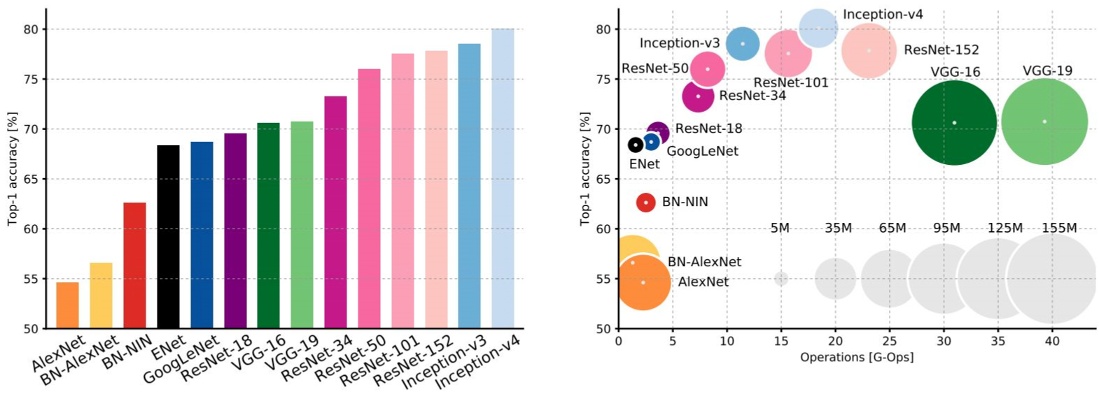
Comparing complexity...
An Analysis of Deep Neural Network Models for Practical Applications, 2017.
Figures copyright Alfredo Canziani, Adam Paszke, Eugenio Culurciello, 2017. Reproduced with permission.
Intro
ResNet
Technical details
Results
ResNet 1000
Comparison

Slide 40
Comparing complexity...
Inception-v4: Resnet + Inception!
An Analysis of Deep Neural Network Models for Practical Applications, 2017.
Intro
ResNet
Technical details
Results
ResNet 1000
Comparison

Slide 41
VGG: Highest
Comparing complexity...
memory, most
operations
An Analysis of Deep Neural Network Models for Practical Applications, 2017.
Intro
ResNet
Technical details
Results
ResNet 1000
Comparison

Slide 42
GoogLeNet:
Comparing complexity...
most efficient
An Analysis of Deep Neural Network Models for Practical Applications, 2017.
Intro
ResNet
Technical details
Results
ResNet 1000
Comparison

Slide 43
AlexNet:
Comparing complexity...
Smaller compute, still memory
heavy, lower accuracy
An Analysis of Deep Neural Network Models for Practical Applications, 2017.
Intro
ResNet
Technical details
Results
ResNet 1000
Comparison

Slide 44
ResNet:
Comparing complexity...
Moderate efficiency depending on
model, highest accuracy
An Analysis of Deep Neural Network Models for Practical Applications, 2017.
Intro
ResNet
Technical details
Results
ResNet 1000
Comparison

Slide 46
Appendix

Slide 47
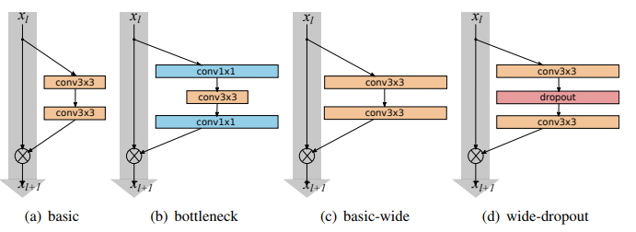
Wide Residual Networks
Wide Residual Networks showed the power of these networks is actually in residual blocks, and that the effect of depth is supplementary at a certain point
It is worth noting that training time is reduced because wider models take advantage of GPUs being more efficient in parallel computations on large tensors even though the number of parameters and floating point operations has increased.
Notes:
width refers to the number of channels in a layer

Slide 48
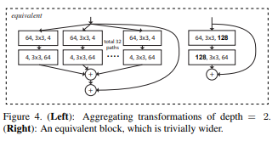
ResNeXt Networks
Residual connections are helpful for simplifying a network’s optimization, whereas aggregated transformations lead to stronger representation power
The aggregated transformation in Eqn.(2) serves as the residual function
where y is the output.
Notes:
the input is split into a few lower — dimensional embeddings (by 1×1 convolutions), transformed by a set of specialized filters (3×3, 5×5, etc…), and merged by concatenation

Slide 49
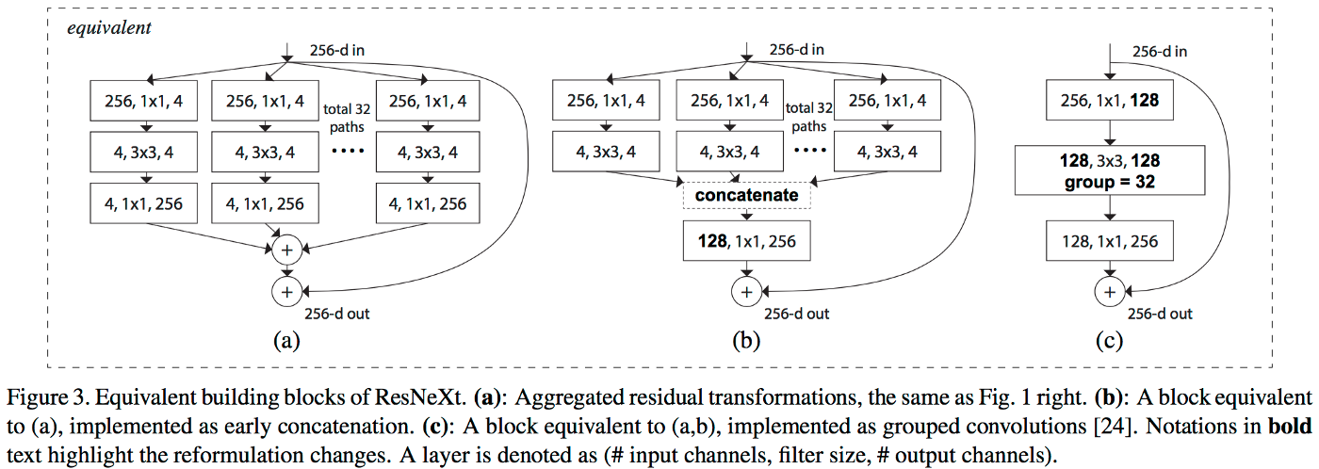
ResNeXt Networks
Notes:
the input is split into a few lower — dimensional embeddings (by 1×1 convolutions), transformed by a set of specialized filters (3×3, 5×5, etc…), and merged by concatenation

Slide 50
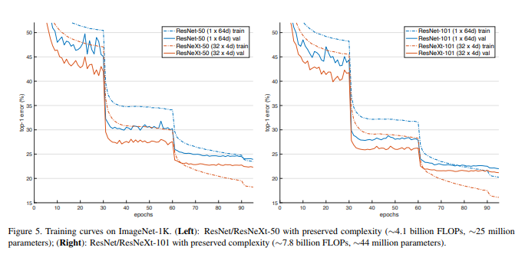
ResNeXt Networks

Slide 51
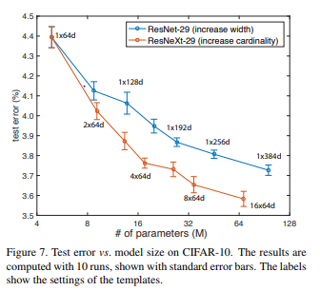
ResNeXt Networks
Test error rates vs. model sizes:
The increasing cardinality is more effective than increasing width
This graph shows the results and model sizes, comparing with the Wide ResNet which is the best published record (observed on ImageNet-1K).

Slide 52
1X1 Convolutions
$$∗$$
$$=$$
1 $×$ 1 $×$ 32
6 $×$ 6 $×$ 32
Notes:
In essence, It’s a fully connected layer for a small part of the previous layer

Slide 53
1X1 Convolutions
1X1 filters are often used to reduce the dimensionality of a layer
ReLU
CONV 1 $×$ 1 $×$ 192
32 Filters
28 $×$ 28 $×$ 32
28 $×$ 28 $×$ 192
[Lin et al., 2013. Network in network]

Slide 54
Inception Network
$$28x28x64$$
1 $×$ 1
$$28x28x128 (same)$$
3 $×$ 3
64
$$28x28x32 (same)$$
5 $×$ 5
128
28
32
32
28
28 $×$ 28 $×$ 192
MAX-POOL
$$28x28x32 \left(same\right)+s=1$$
[Szegedy et al. 2014. Going deeper with convolutions]

Slide 55
Inception Networks: Computational Cost
CONV
5 $×$ 5,
same,
32
28 $×$ 28 $×$ 32
28 $×$ 28 $×$ 192

Slide 56
Inception Networks with 1X1 Convolutions
CONV
1 $×$ 1,
16,
1 $×$ 1 $×$ 192
CONV
5 $×$ 5,
32,
5 $×$ 5 $×$ 16
28 $×$ 28 $×$ 16
28 $×$ 28 $×$ 32
28 $×$ 28 $×$ 192

Slide 57
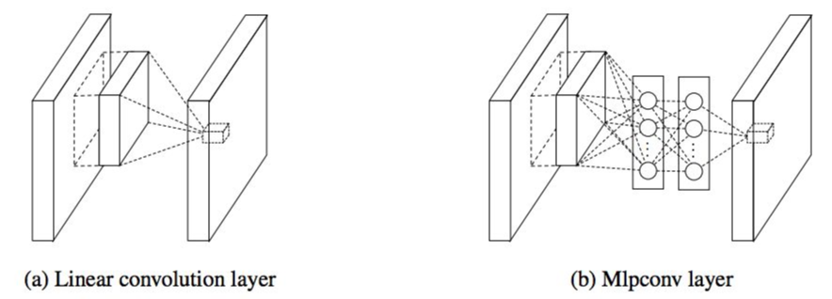
Network in Network (NiN)
[Lin et al. 2014]
-
Mlpconv layer with
“micronetwork” within each conv
layer to compute more abstract
features for local patches
-
Micronetwork uses multilayer
perceptron (FC, i.e. 1x1 conv
layers)
-
Precursor to GoogLeNet and
ResNet “bottleneck” layers
-
Philosophical inspiration for
GoogLeNet
Figures copyright Lin et al., 2014. Reproduced with permission.

Slide 58
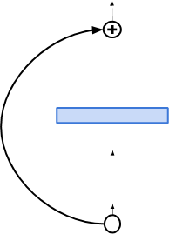
Improving ResNets...
Identity Mappings in Deep Residual Networks
[He et al. 2016]
-
Improved ResNet block design from
creators of ResNet
conv
-
Creates a more direct path for
ReLU
propagating information throughout
BN
network (moves activation to residual
mapping pathway)
conv
-
Gives better performance
ReLU
BN

Slide 59
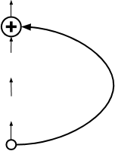
Improving ResNets...
Wide Residual Networks
[Zagoruyko et al. 2016]
-
Argues that residuals are the
important factor, not depth
-
User wider residual blocks (F x k
3x3 conv, F
3x3 conv, F x k
filters instead of F filters in each layer)
-
50-layer wide ResNet outperforms
3x3 conv, F
3x3 conv, F x k
152-layer original ResNet
-
Increasing width instead of depth
more computationally efficient
Basic residual block
Wide residual block
(parallelizable)

Slide 60
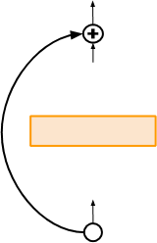
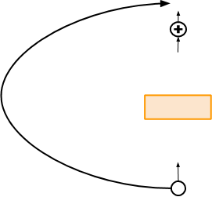
Improving ResNets...
Aggregated Residual Transformations for Deep
Neural Networks (ResNeXt)
[Xie et al. 2016]
256-d out
-
Also from creators of
ResNet
256-d out
-
Increases width of
1x1 conv, 256
1x1 conv, 256
1x1 conv, 256
1x1 conv, 256
residual block through
multiple parallel
32
3x3 conv, 64
paths
pathways
3x3 conv, 4
3x3 conv, 4
...
3x3 conv, 4
(“cardinality”)
1x1 conv, 64
-
Parallel pathways
1x1 conv, 4
1x1 conv, 4
1x1 conv, 4
similar in spirit to
256-d in
Inception module
256-d in

