Slide 1
R-CNN region
By Ilia Iofedov
BGU, DNN course 2016

Slide 2
Sources
Main paper
“Rich feature hierarchies for accurate object detection and semantic segmentation”, Ross Girshick, Jeff Donahue, Trevor Darrell, Jitendra Malik; UC Berkeley 2014
Additional sources:
Stanford course: Convolutional Neural Networks for Visual Recognition
Ross Girshick papers and slides

Slide 3
Introduction
Computer vision problems:
Classification
Localization
Detection
Segmentation

Slide 4
Classification problem
The problem is decide what is shown on the picture : a dog or a cat
Solution
ConvNet
AlexNet

Slide 5
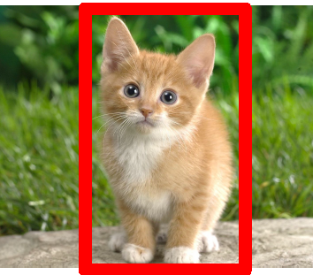
Localization problem
The localization problem:
Is it a cat (or cats) on a picture
The number of cats is known
Draw a box around the cat

Slide 6
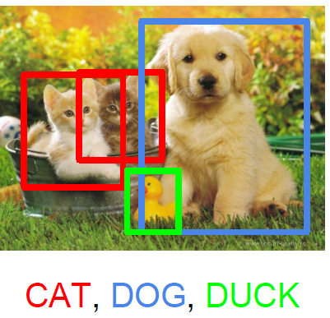
Detection problem
The detection problem:
Find all cats and dogs on the picture
The number of cats and dogs isn’t known
Draw a box around each cat

Slide 7
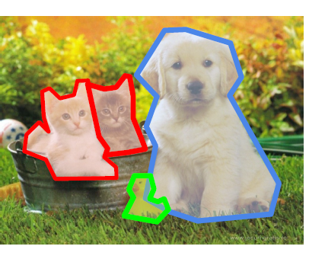
Segmentation problem
The segmentation problem:
Find all cats on the picture
The number of cats isn’t known
Mark all pixels belong to the cats (draw a couture)

Slide 8
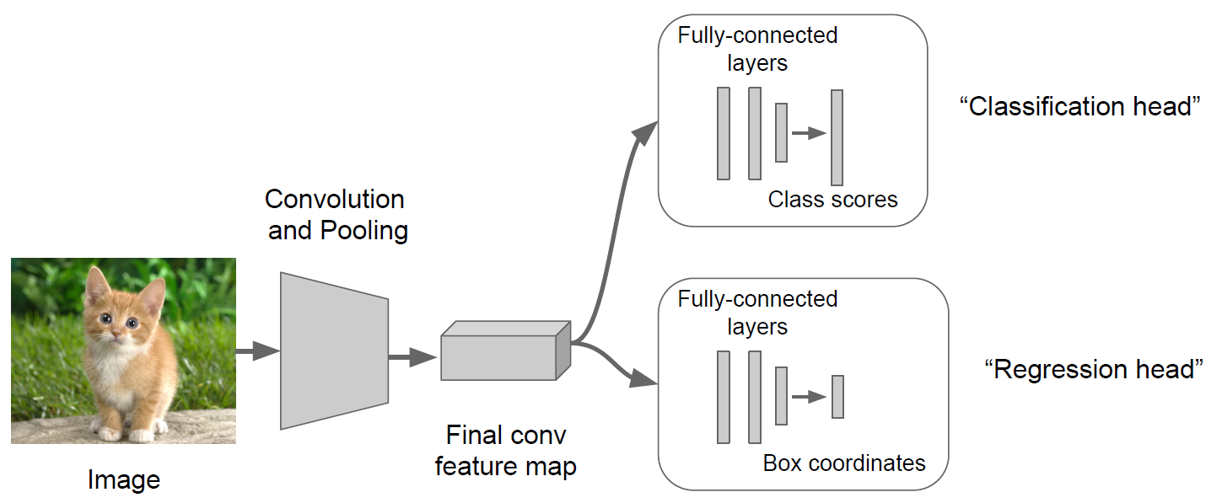
Localization Method Localization regression network
Classification + Localization
The output :
Class
Box is defined by (x, y, w, h)
Classification + Localization regression network
class
Softmax loss
(x,y,w,h)
L2 loss

Slide 9
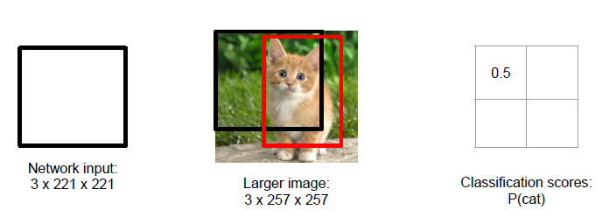
Localization Method Sliding Window: Overfeat
Run classification + regression network at multiple locations on a high resolution image
Combine classifier and regressor predictions across all locations for final prediction

Slide 10
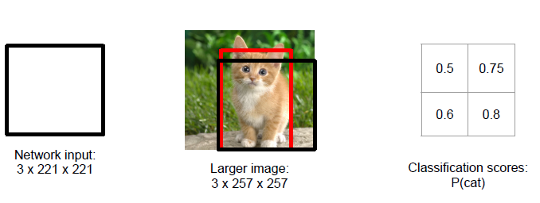
Localization Method Sliding Window: Overfeat
Run classification + regression network at multiple locations on a high resolution image
Combine classifier and regressor predictions across all locations for final prediction

Slide 11
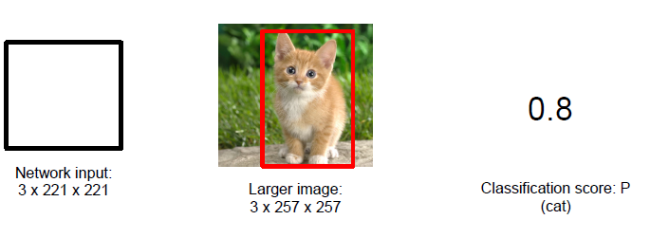
Localization Method Sliding Window: Overfeat
Run classification + regression network at multiple locations on a high resolution image
Combine classifier and regressor predictions across all locations for final prediction
Overfeat method reduces the complexity by joint calculations

Slide 12
Detection
Sliding Window
Apply window all possible positions and scales
Very complex
Pre-processing for feature extraction
Histogram of oriented gradients (HOG)
Next run linear classifier on all possible positions

Slide 13
Detection
We would like to run CNN on many positions and scales
Problem: It is too complex
Solution: Run CNN on sub-set of the positions, which are most likely representing the desired object

Slide 14
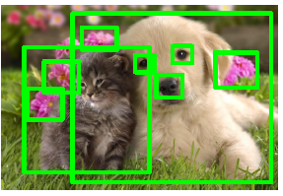
Region proposals
Selective search
Grouping
Edge boxes
Window scoring
Good comparison: “What makes for effective detection proposals?”, Jan Hosang at el

Slide 15
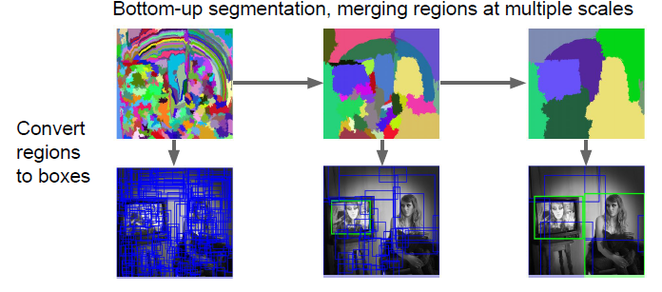
Selective search
Start form a set of pixels
Merge similar color pixels to the regions

Slide 16
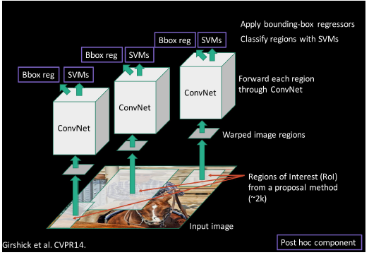
R-CNN Idea

Slide 17
R-CNN Idea
Region proposals (selective search)
~2000 per image
Wrap each region to predefined size sub-image
Run CNN on each sub-image for 4096 future extraction
Classification (per class SVM)
Regression of localization

Slide 18
R-CNN training
Step1:
Start with trained CNN (AlexNet) trained on ImegeNet (1000 classes)
Step 2:
Modify the last fully connected layer to output 21 classes scores (20 +background)
Train CNN with PASCAL VOC data set (20 classes)
Step 3:
Run region propose algorithm on the images set
Wrap the regions to sub-images
Run forward the sub-images through the CNN and save the feature pool layer outputs
Step 4:
Train the SVMs using save before features.
Separate binary SVM for each class
Step 5
For each class train box regression.
Linear regression model is used.
The goal is a final tuning of the proposed region

Slide 19
Performance evaluation
Metric : mean average precision (mAP) 0-100%
A detection is succeeded, if the class is correct and Intersection of Unions (IoU) with the true object box < threshold ( e.g. 0.5)
Data sets
PASCAL VOC: 20 classes, ~20K images
ILSVRC 2014: 200 classes, ~470K images

Slide 20
Results VOC 2010 test

Slide 21
Results

Slide 22
Problem of R-CNN
Slow at test time: needs to run full forward pass for each region proposal
Complicated and far from optimal training
SVM is CNN are trained as separated systems

Slide 23
Fast R-CNN
First applies CNN on large scale image, the output is feature map
Shared computation for the proposed regions
Poling of the regions of interest the feature map
The rest is the same as in R-CNN

Slide 24
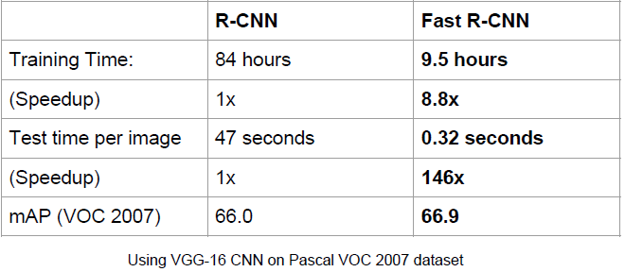
Fast R-CNN
Simple training
Less computation at the test time

Slide 25
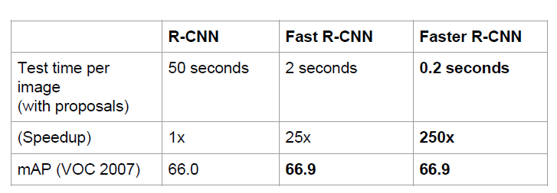
Faster R-CNN
In fast R-CNN, the bottle neck is region proposal method
A new region proposal network
Simplified training
Speed up X200 as compared to R-CNN

Slide 26
Questions ?
Thank you

